Slide 2
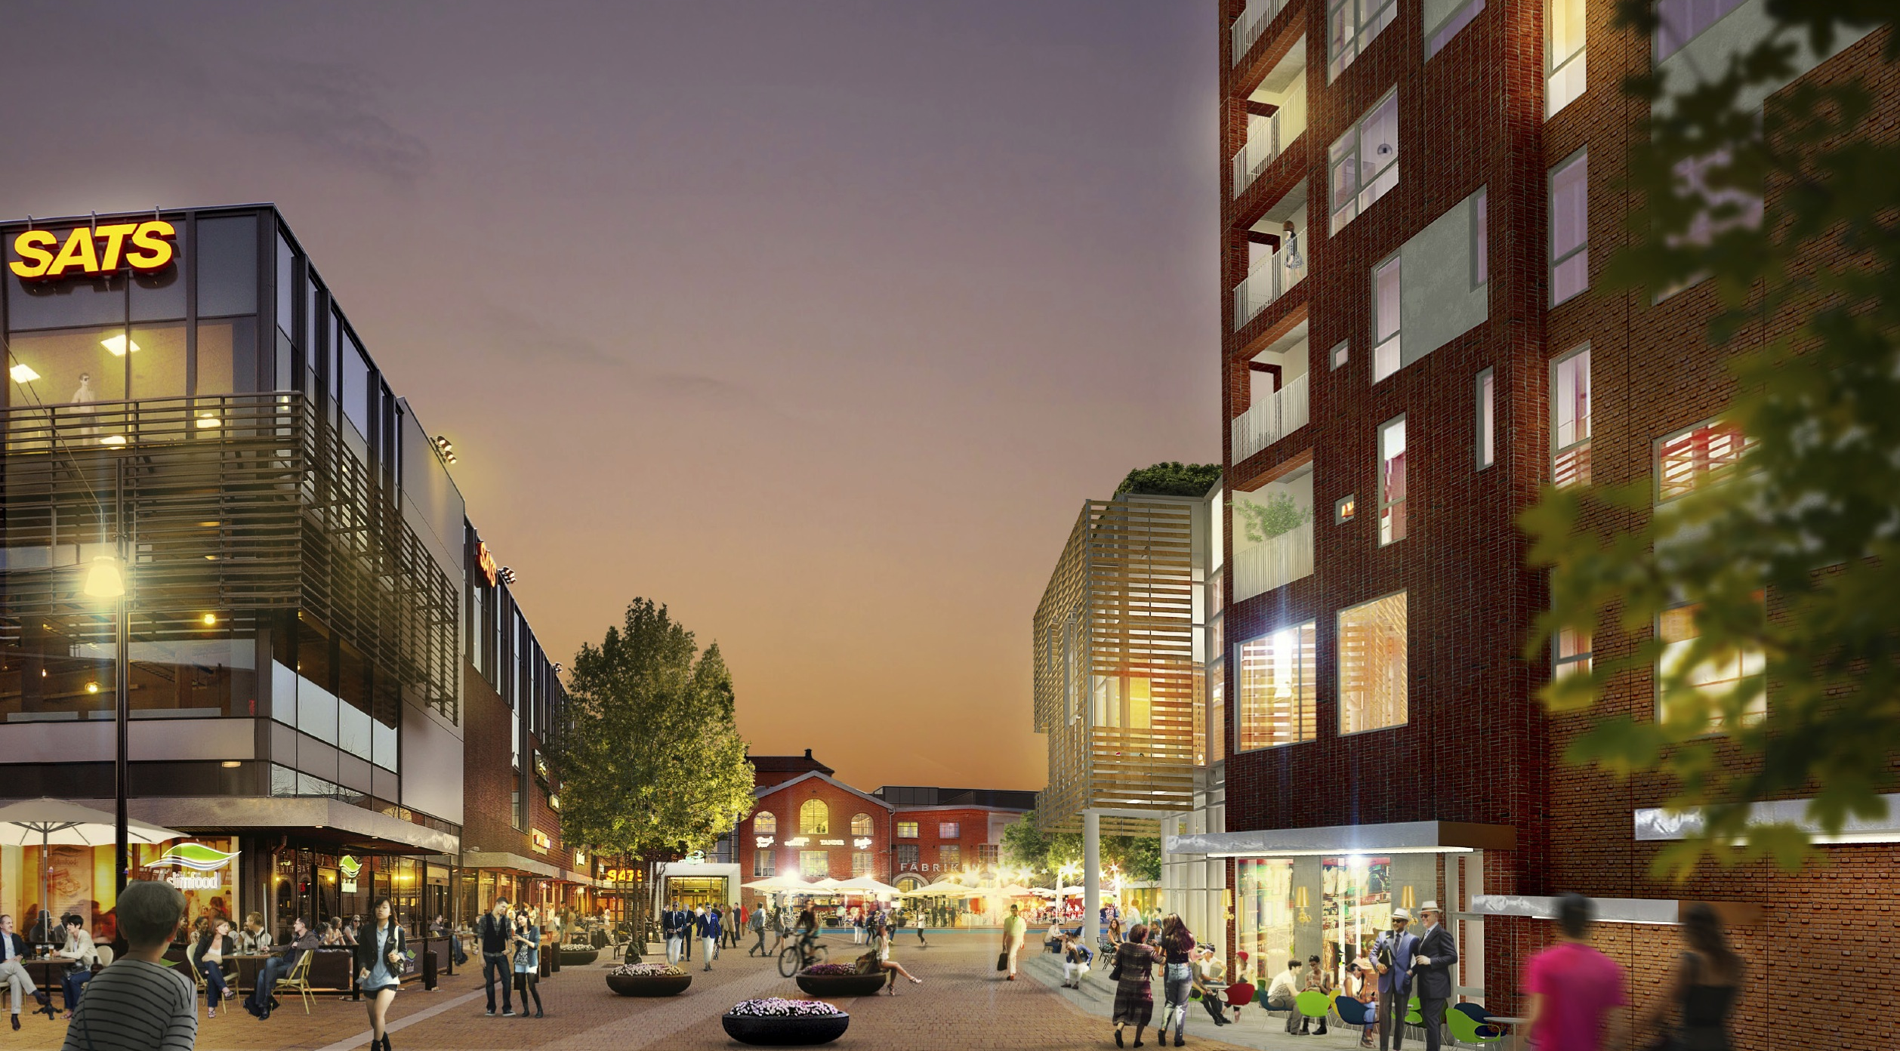

Creating
innovative urban environments
2
Notes:
Annan bild?
Strategier och värdedrivande faktorer….
E-handel. Hur ser vi på det?

Slide 3
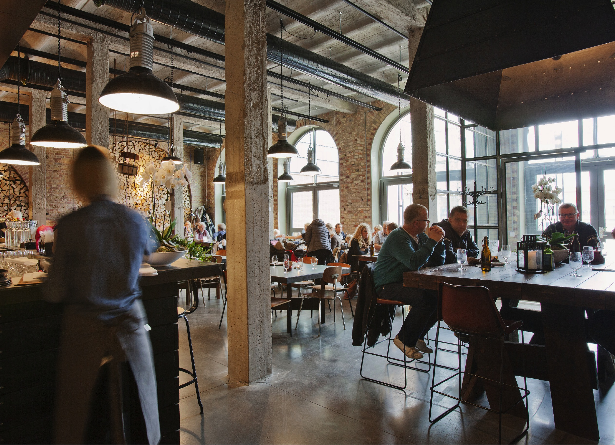

OUR OFFER
One of Sweden’s largest listed real estate company with a clear focus on development and property management
Full-service environments with retail, offices, residential, service, culture and education
A high quality property portfolio with exposure to growing regions provides an opportunity for good value growth over time
A stable business and strong financial position with solid key ratios such as low gearing ratio and high interest coverage ratio
3
3

Slide 4

STRATEGIES FOR VALUE GROWTH
Sustainable urban development
Strong subsidiary markets in growth towns
Significant player with large units
Long-term partnerships that focus on the customer
Large project portfolio
In-house expertise and experience
Passionate employees and widely supported core values
4

Slide 5
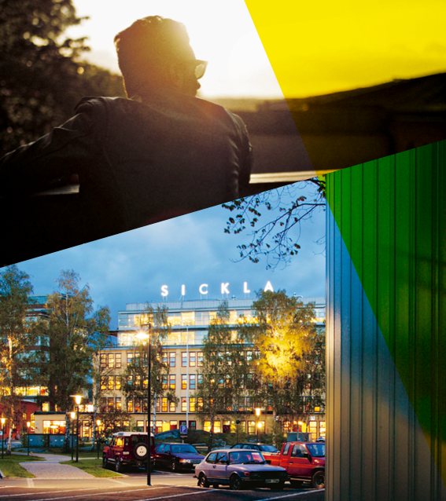
MARKET SITUATION
Strong office rents
E-commerce is affecting retailers
Strong demographic growth in our locations
Vacancies are low and stable
Property yields are low and stable
Atrium Ljungberg well positioned
5
Notes:
Office rents have climbed to record levels in Stockholm CBD but the rate of growth is showing signs of slowing down as rent levels on new lease agreements are stabilising.
E-commerce has become the sole driving factor behind consumer goods sales growth and that is likely to remain the case for the foreseable future. We believe that retail locations that cannot offer anything more than good will have a hard time in the digital age. Our retail properties are part of urban delevelopment and are a key component in the synergies we aim to create. We are creating urban centres that offer functions and experiences, places were people will want to be. And interesting retail experiences is part of that picture.
Our properties are located in some of the fastest growing population centres in Sweden and will thus be even more attractive in the long term.
The strength of the Swedish economy is providing a solid foundation for demand in the rental market and vacancies are at low levels.
Easy access to funding have compressed property yields over the last few years and yield levels continue to be low.
The current environment is very favourable to Atrium Ljungbergs strategy of fucusing on well situated high quality properties.

Slide 6
ATRIUM LJUNGBERG IN BRIEF
13%
Number of properties | 51
Property value | SEK 44 billion
Contracted annual rent | SEK 2,5 billion
Lettable area | 1 129 000 m²
Letting rate | 95 %
72%
6%
Contracted annual rent per premises type
9%

Slide 7

GOALS
Profitability and growth
Long-term stability
Corporate Social Responsibility
7
Notes:
(Martin tar uppföljningen befintliga mål)

Slide 8
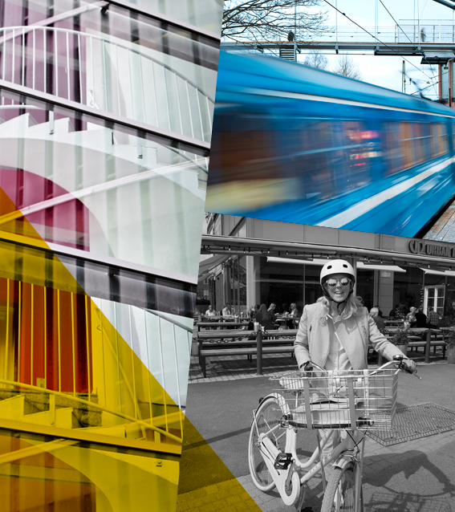
FINANCIAL TARGETS 2018
Investments > SEK 1 billion per year
Project return > 20%
Increase in operating surplus > 10% per year
Dividend > 50% of the profit before changes in value, after nominal tax
8

Slide 9
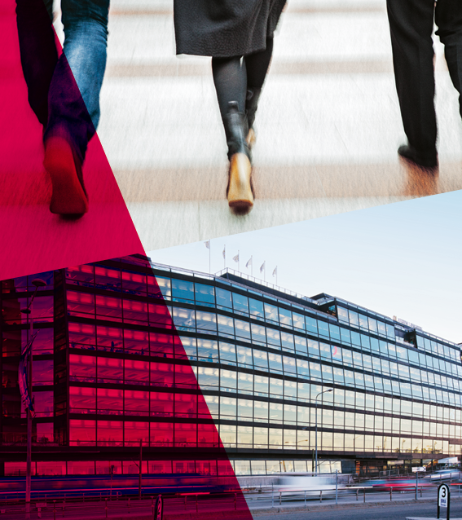
FINANCIAL TARGETS 2018
The minimum equity/assets ratio is to be 30%
The minimum interest coverage ratio is to be a multiple of 2.0
9

Slide 10
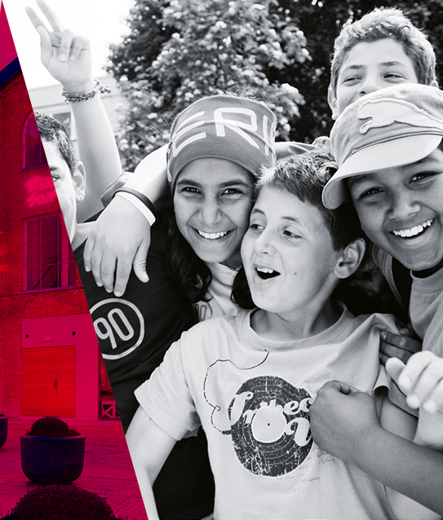
CORPORATE SOCIAL RESPONSIBILITY
Integrated part of the business model
Environmental and resource-efficiency targets
One of Sweden’s best workplaces
10

Slide 11
NEW FINANCIAL TARGETS 2019
Net operating income is replaced by return on equity. Target 10% over time.
Equity ratio is replaced by loan-to-value ratio. Measure max 45%.
The investment target is raised from SEK 1 billion per year to SEK 2 billion.
The targets for project profit, interest coverage ratio, dividend and sustainability are maintained unchanged.
Return on Equity (%)
Loan to Value (%)
Investments (MSEK)

Slide 12
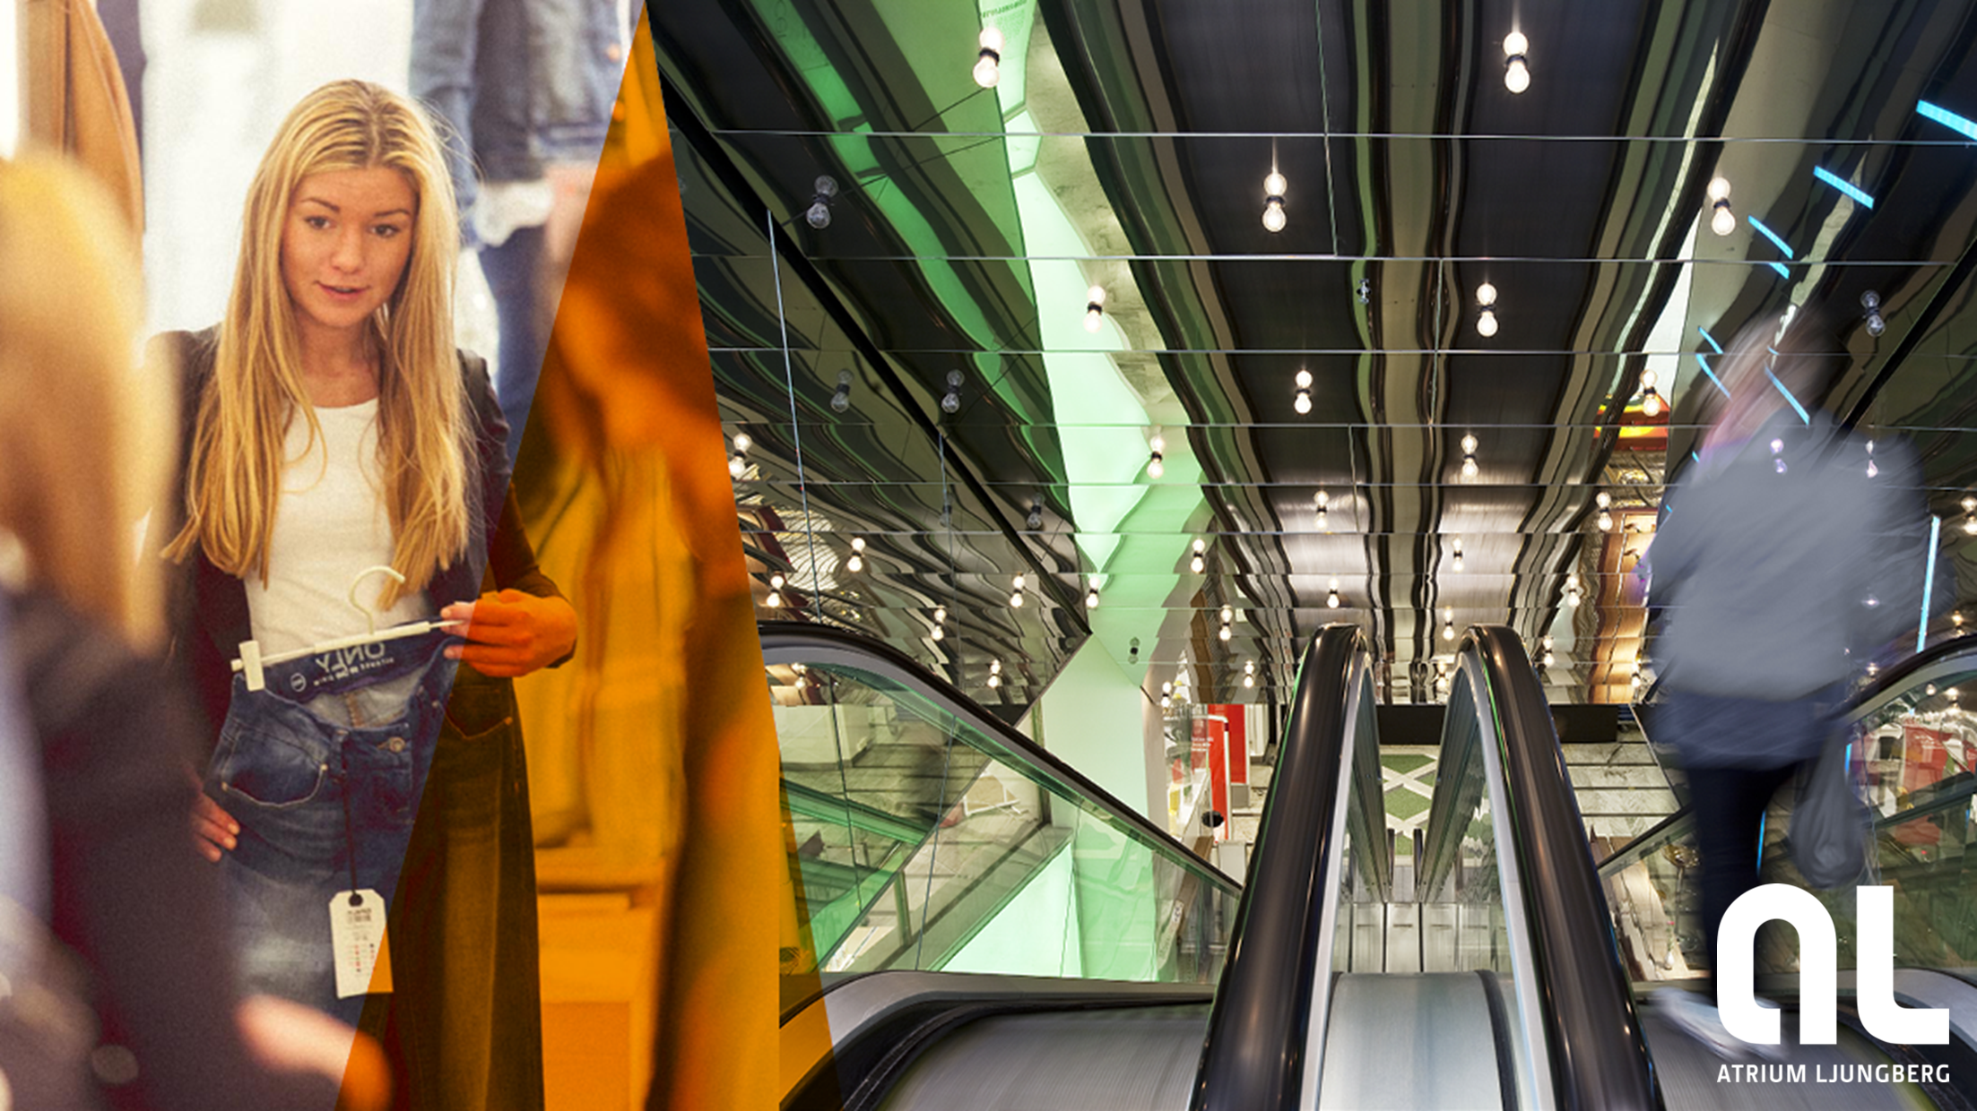
MARKET
12

Slide 13
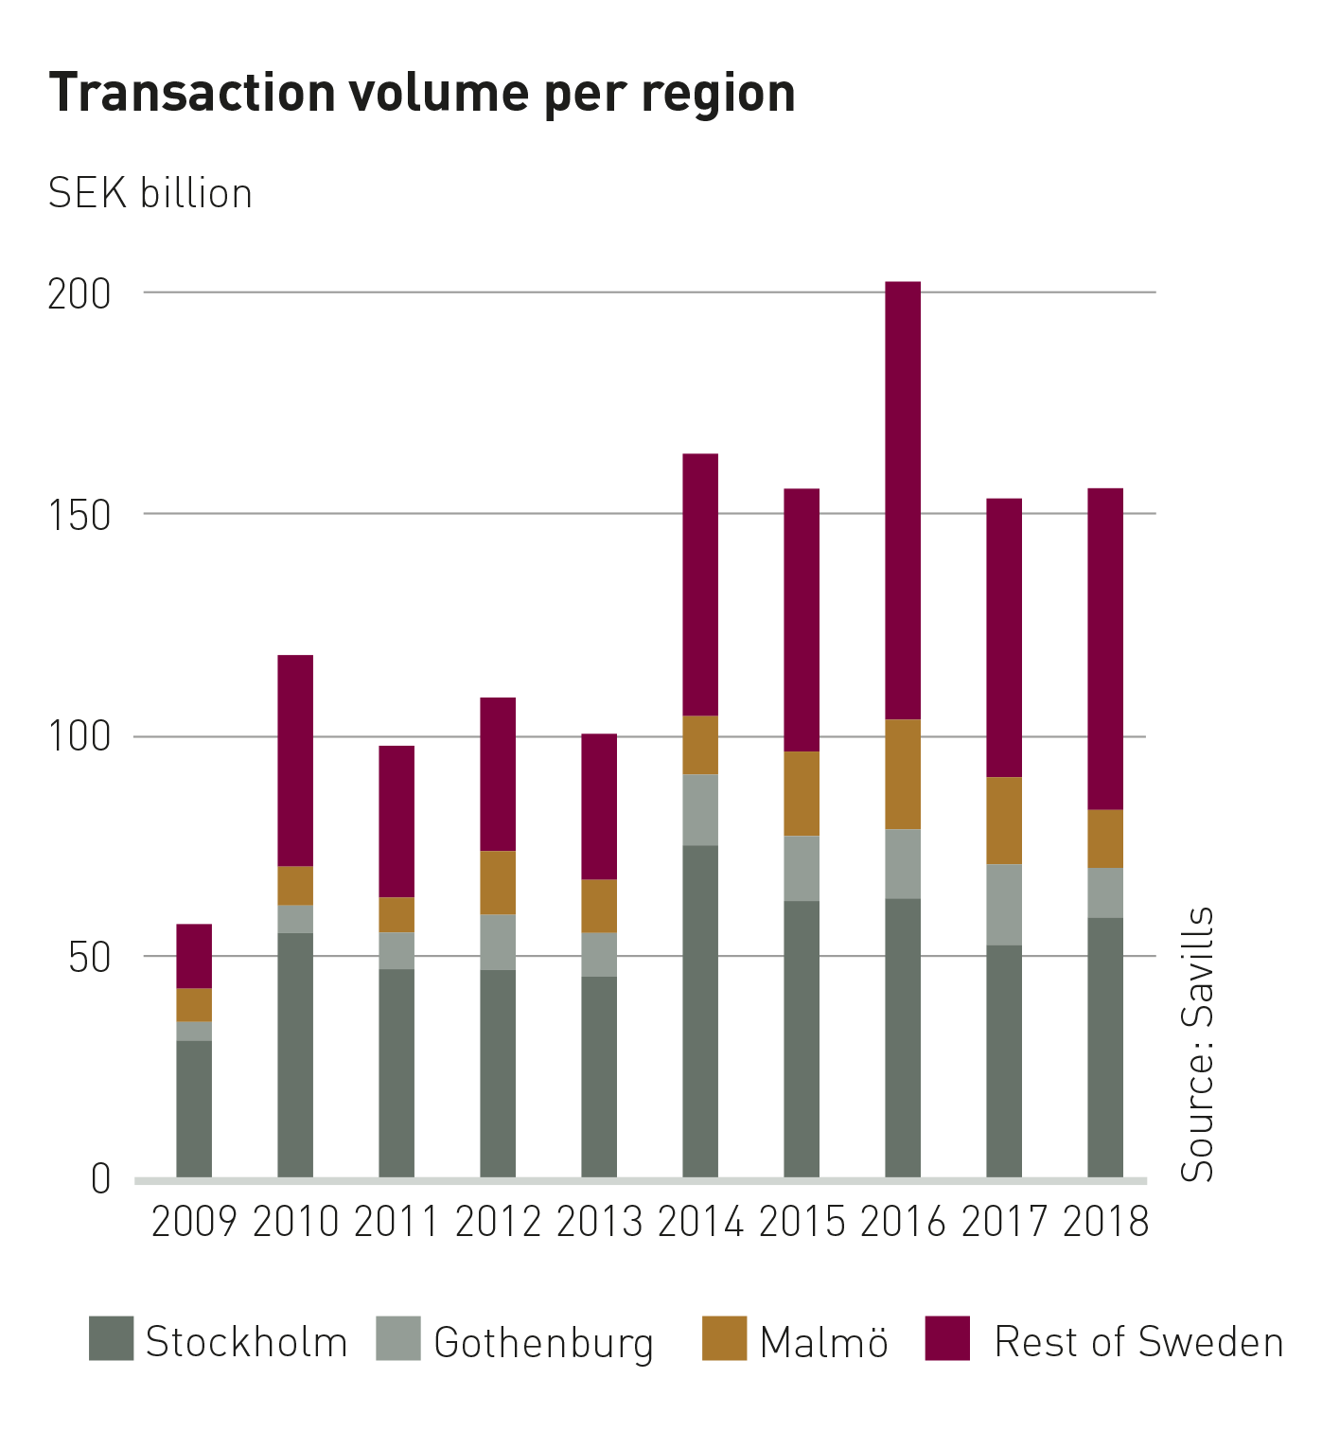
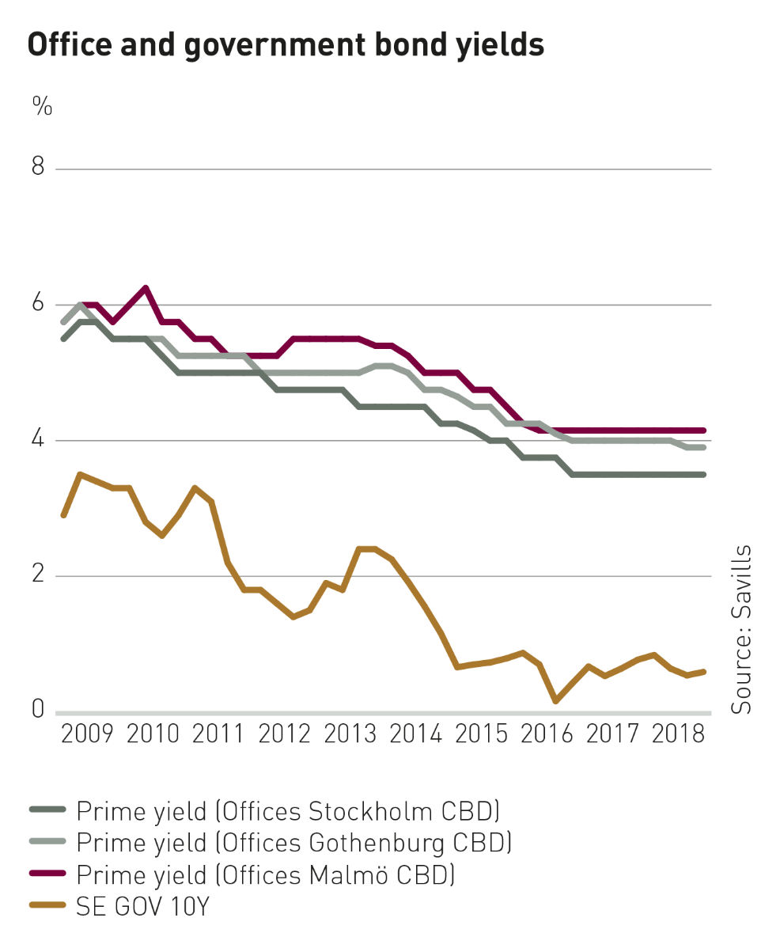
STRONG PROPERTY MARKET
Source: Savills
13

Slide 14
OFFICES: LOW VACANCIES KEEPING DEMAND UP
Contracted annual rent (SEK per m²)
Source: Savills

Slide 15
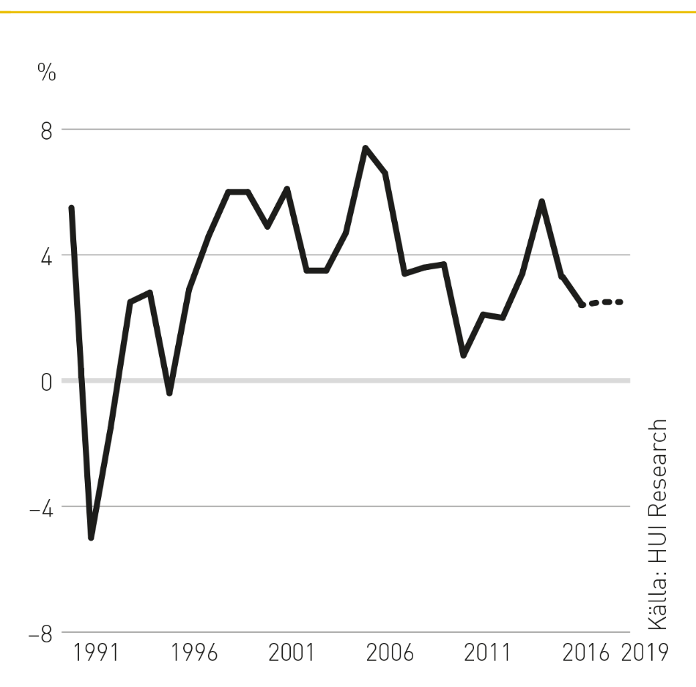
Retail sales grew by 2.5% during 2018
Notes:
E-handeln ökade med 17 %. Detaljhandeln 3,3 %.

Slide 16
Residential market
Housing prices (real SEK per m²)
New housing for sale (n:o)
Queue (years) new production
Source: Värderingsdata
Source : Booli
Source : Bostadsförmedlingen Stockholm
Notes:
E-handeln ökade med 17 %. Detaljhandeln 3,3 %.

Slide 17
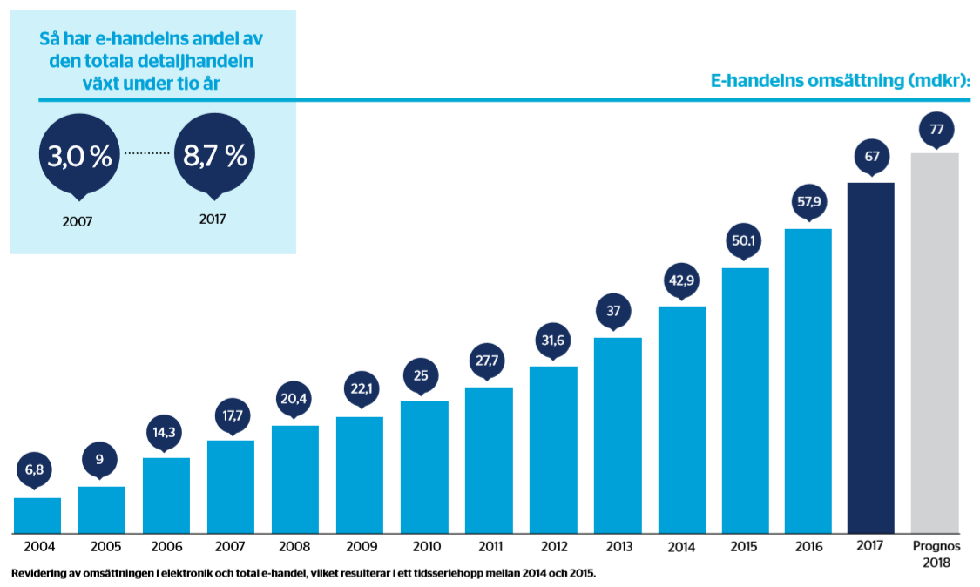
STRONG GROWTH IN E-COMMERCE
SEK 10 billion/15% growth, 10% market share
e-commerce sales (SEK billion)
Source: e-barometern
17
Notes:
E-handeln ökade med 17 %. Detaljhandeln 3,3 %.
City?

Slide 18
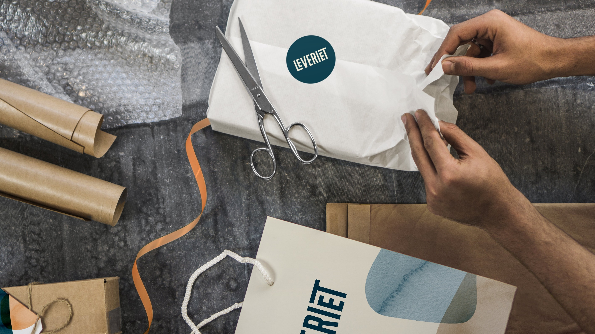
LAST MILE E-COMMERCE
Notes:
E-handeln ökade med 17 %. Detaljhandeln 3,3 %.
City?

Slide 19
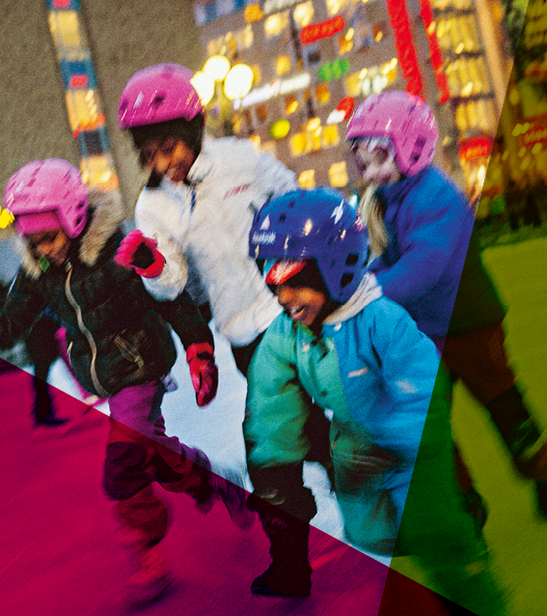
SUBSIDIARY MARKETS - GROWTH
Population growth in 2015 and forecast until 2035
 | Municipality | Population | Population growth | Growth (%) | Forecast 2010-2035
1 | Stockholm | 912,401 | 10,757 | 1.2 % | 27 %
2 | Gothenburg | 540,786 | 6,772 | 1.3 % | 14 %
3 | Malmö | 317,375 | 4,595 | 1.4 % | 22 %
4 | Helsingborg | 134,978 | 2,578 | 1.9 % | 17 %
5 | Uppsala | 207,611 | 2,392 | 1.2 % | 18 %
6 | Nacka | 95,842 | 1,966 | 2.1 % | 34 %
7 | Sundbyberg | 43,841 | 1,920 | 4.4 % | 29 %
8 | Örebro | 43,841 | 1,887 | 1.3 % | 15 %
9 | Järfälla | 70,417 | 1,826 | 2.6 % | 21 %
10 | Norrköping | 135,096 | 1,767 | 1.3 % | 11 %
11 | Västerås | 143,543 | 1,732 | 1.2 % | 9 %
12 | Solna | 74,374 | 1,689 | 2.3 % | 29 %
13 | Umeå | 119,452 | 1,491 | 1.2 % | 10 %
14 | Linköping | 151,702 | 1,442 | 1.0 % | 14 %
15 | Haninge | 82,148 | 1,344 | 1.6 % | 21 %
 | Sweden | 9,737,559 | 100,859 | 1.0 % | 11 %
19
Source: SCB
19

Slide 20
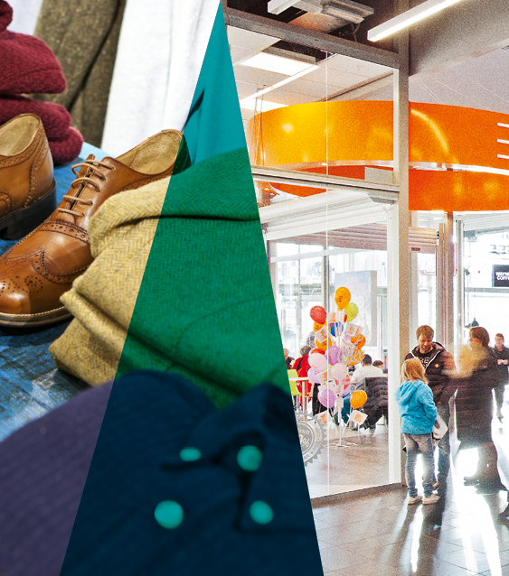
LARGEST RETAIL CENTERS IN SWEDEN
 | Sales 2017 (billion SEK)
1 | Mall of Scandinavia | 4.3
2 | Nordby Shoppingcenter | 4.3
3 | Nordstan | 4.2
4 | Täby Centrum | 3.6
5 | Sickla Köpkvarter | 3.2
6 | Frölunda Torg | 3.0
7 | Emporia | 2.9
8 | Charlottenberg Shoppingcenter | 2.5
9 | Farsta Centrum | 2.5
10 | Väla Centrum | 2.5
11 | Gränby Centrum | 2.1
12 | Kista Galleria | 2.1
13 | Bromma Blocks | 2.1
14 | Liljeholmstorget | 1.9
15 | Allum | 1.8
16 | Mobilia | 1.8
20

Slide 21
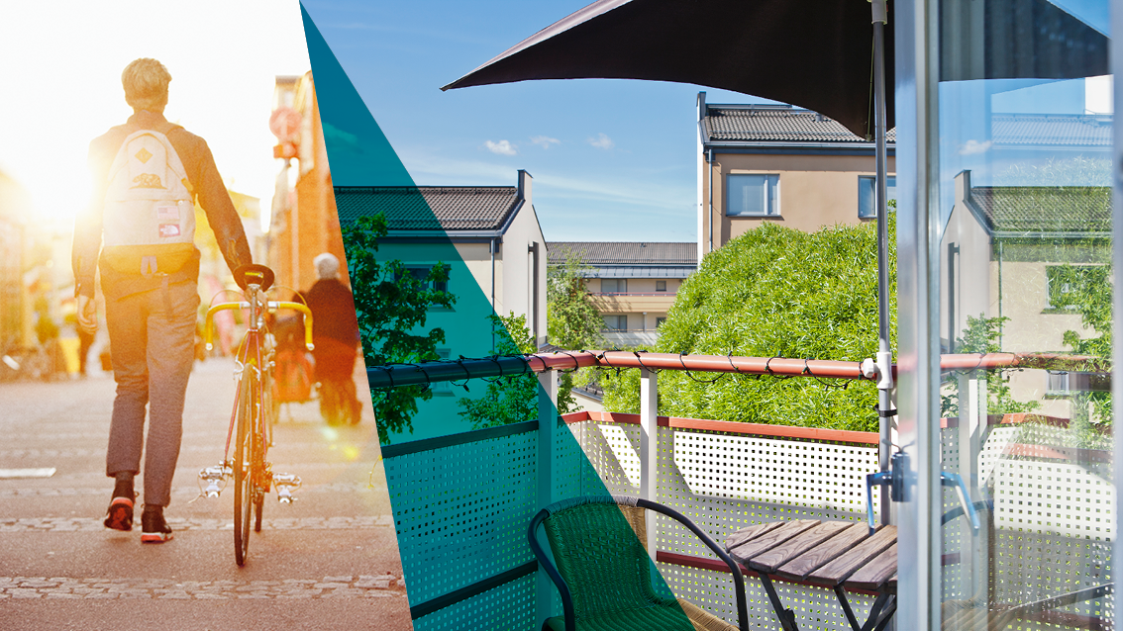
Stark befolkningsökning på våra delmarknader
Befolkningsökning 2015 och prognos till 2035
 | Kommun | Folkmängd | Folkökning | Procentuell ökning | Prognos ökning 2010-2035
1 | Stockholm | 912 401 | 10 757 | 1,2 % | 27 %
2 | Göteborg | 540 786 | 6 772 | 1,3 % | 14 %
3 | Malmö | 317 375 | 4 595 | 1,4 % | 22 %
4 | Helsingborg | 134 978 | 2 578 | 1,9 % | 17 %
5 | Uppsala | 207 611 | 2 392 | 1,2 % | 18 %
6 | Nacka | 95 842 | 1 966 | 2,1 % | 34 %
7 | Sundbyberg | 43 841 | 1 920 | 4,4 % | 29 %
8 | Örebro | 43 841 | 1 887 | 1,3 % | 15 %
9 | Järfälla | 70 417 | 1 826 | 2,6 % | 21 %
10 | Norrköping | 135 096 | 1 767 | 1,3 % | 11 %
11 | Västerås | 143 543 | 1 732 | 1,2 % | 9 %
12 | Solna | 74 374 | 1 689 | 2,3 % | 29 %
13 | Umeå | 119 452 | 1 491 | 1,2 % | 10 %
14 | Linköping | 151 702 | 1 442 | 1,0 % | 14 %
15 | Haninge | 82 148 | 1 344 | 1,6 % | 21 %
 | Sverige totalt | 9 737 559 | 100 859 | 1,0 % | 11 %
PROPERTES AND PROJECT PORTFOLIO
21
Källa: SCB

Slide 22
PROPERTY PORTFOLIO
Property portfolio by property type | Letting area (1,000 m²) | Fair value (SEK billion) | Fair value (SEK/sqm) | Letting rate (%)
Office properties | 654 | 22,517 | 43,893 | 94
Retail properties | 321 | 14,297 | 51,672 | 95
Residential properties | 81 | 1,768 | 25,502 | 98
Total | 1,055 | 38,582 | 44,914 | 95
Investment properties | 68 | 3,851 |  | 85
Land and development rights | - | 877
Development properties | 6 | 890
Total | 1,129 | 44,201 |  | 95
YIELD REQUIREMENT PER PREMISES TYPE, %
YIELD REQUIREMENT PER REGION, %
Premises type | Range | Average
Offices | 3.6-6.3 | 4.5
Retail | 3.7-6.2 | 4.9
Residential | 2.9-3.8 | 3.2
Other | 3.7-6.3 | 5.0
Total | 2.9-6.3 | 4.6
Region | Range | Average
Stockholm | 2.9-6.3 | 4.5
Uppsala | 4.5-5.8 | 5.2
Malmö | 3.8-5.9 | 5.4
Gothenburg | 4.5-4.5 | 4.5
Totalt | 2.9-6.3 | 4.6
22

Slide 23
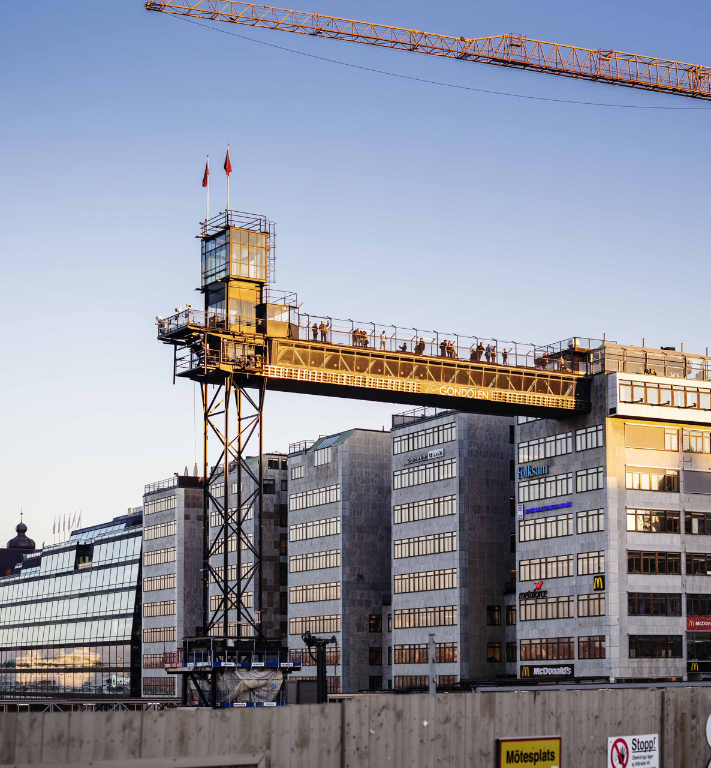
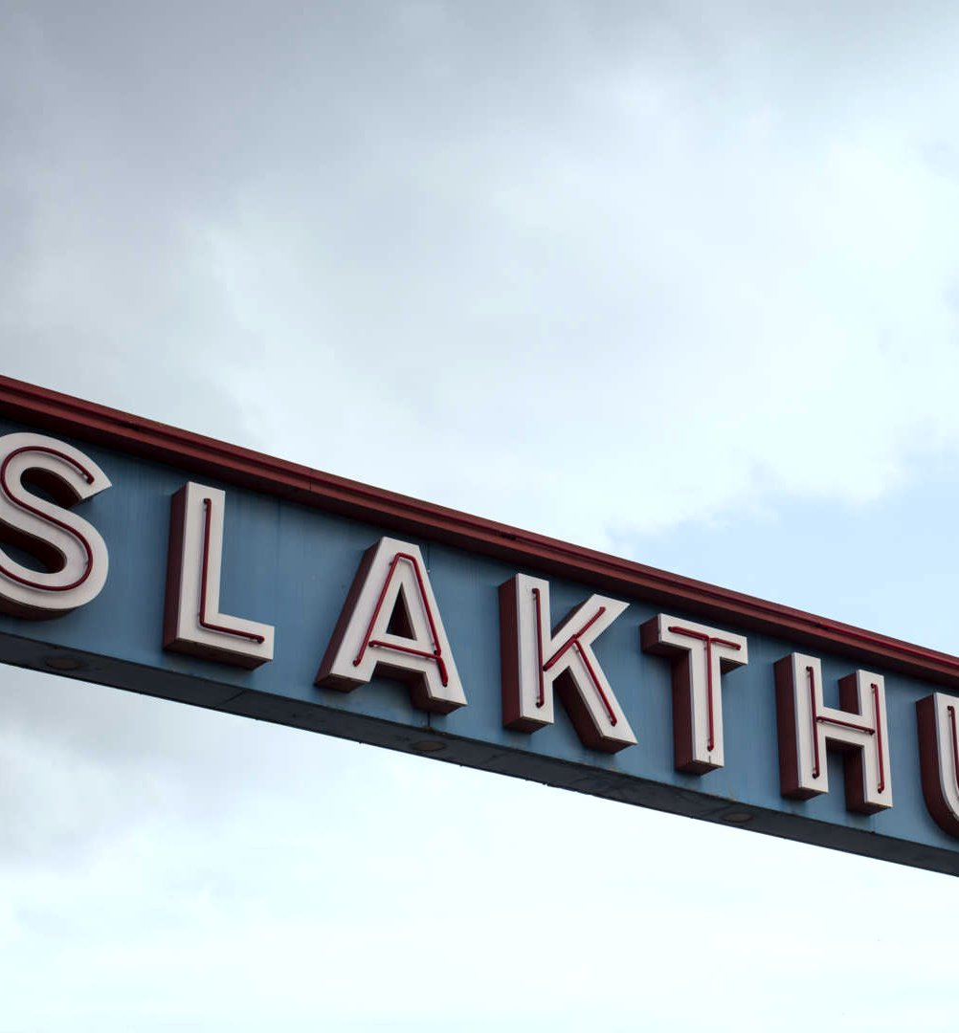
Property exchange
AT SLUSSEN
Acquisition of Kylfacket

Slide 24
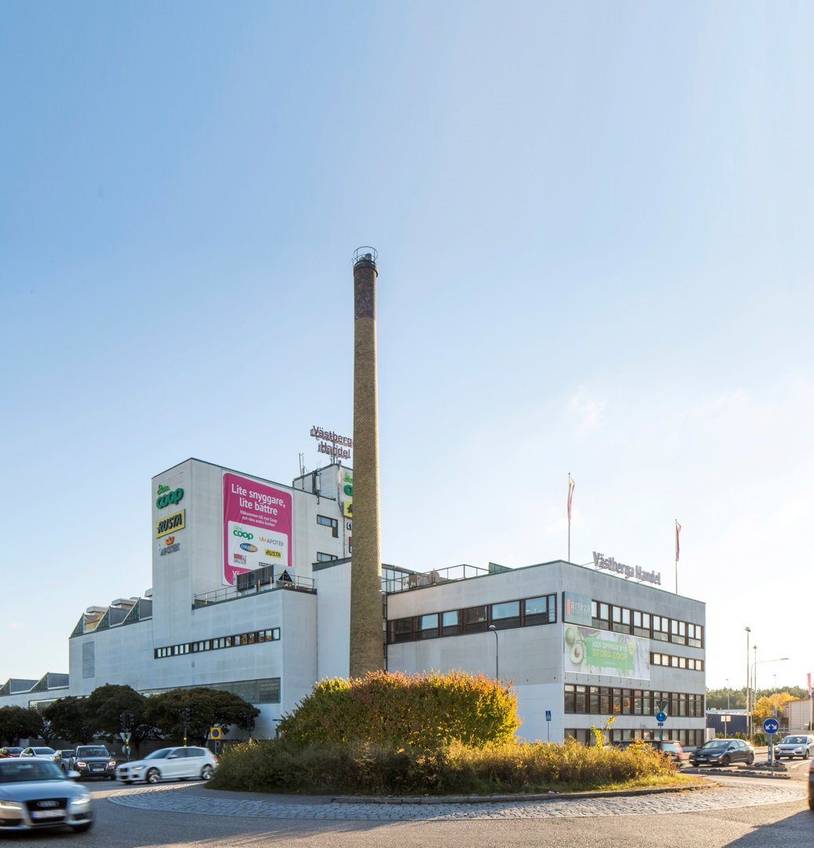
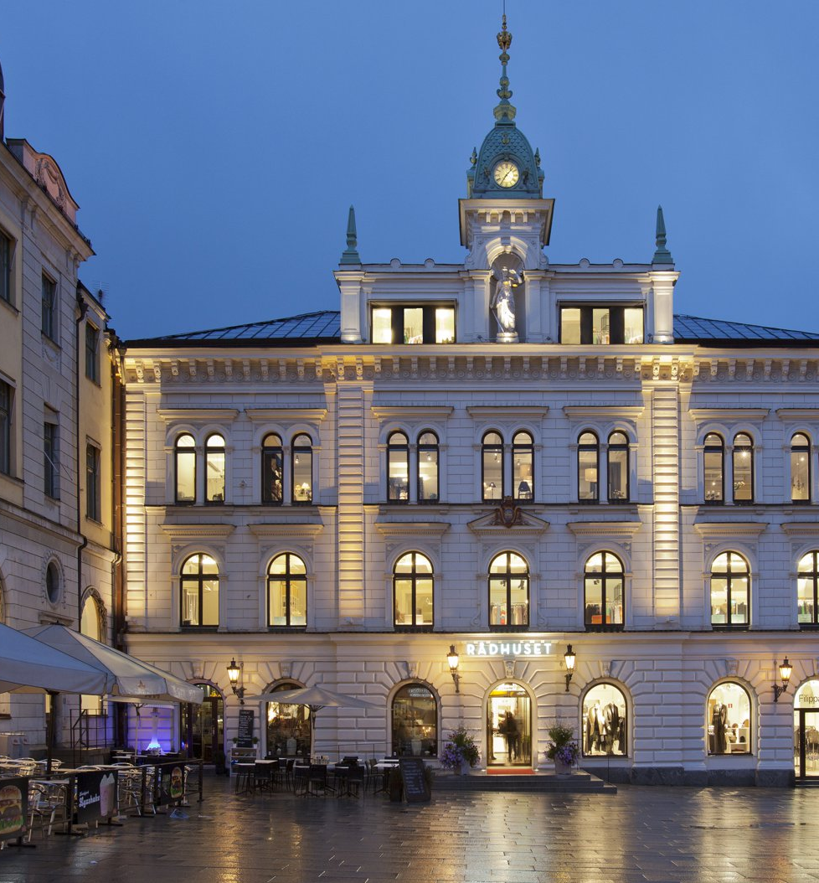
divestment of
VÄSTBERGA handel
divestment of
rådhuset

Slide 25
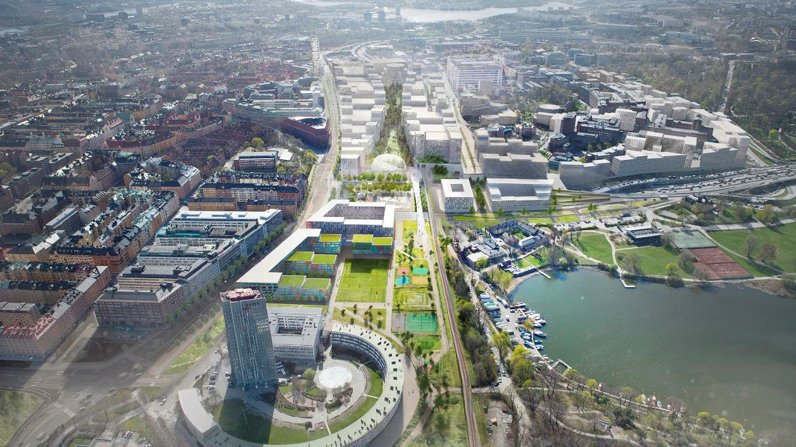
Land allocation at HAGASTADEN

Slide 26
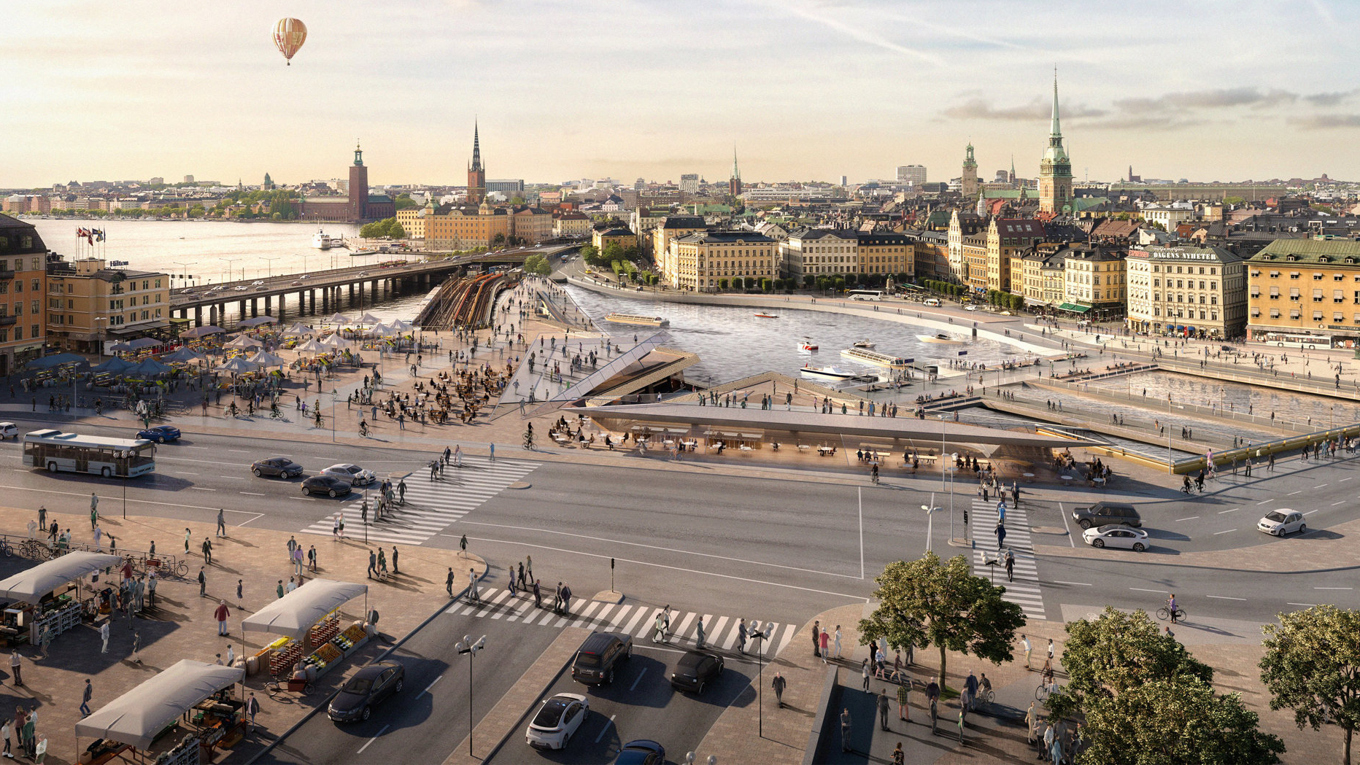
Land allocation at SLUSSEN

Slide 27
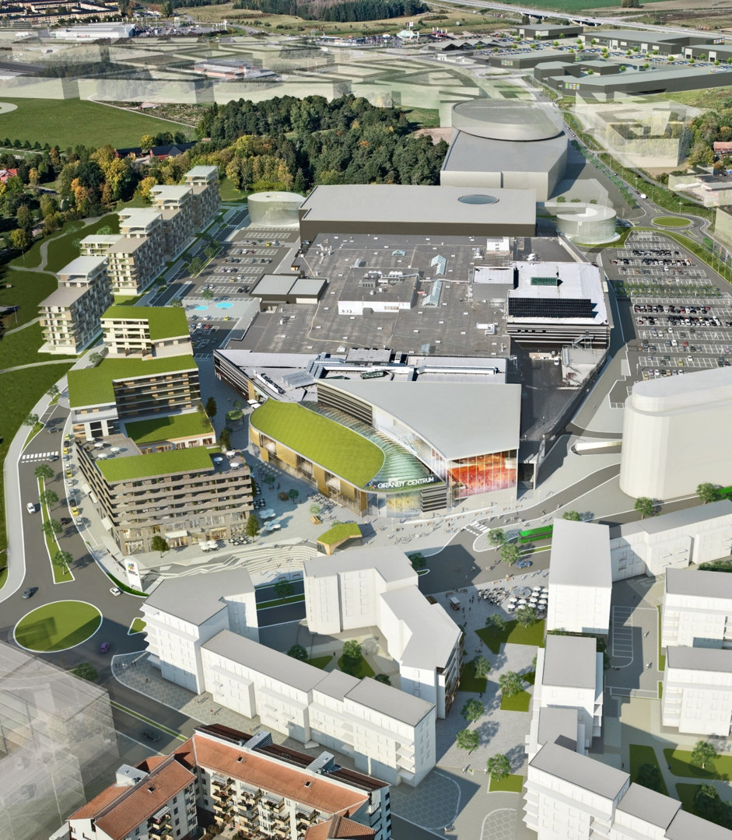
Extensive project portfolio
Remaining investment (MSEK)
Ongoing projects | 3,800
Potential projects* (approx.) | 17,000
Total (approx.) | 21,000
*Excl. projects at Slakthusområdet

Slide 28
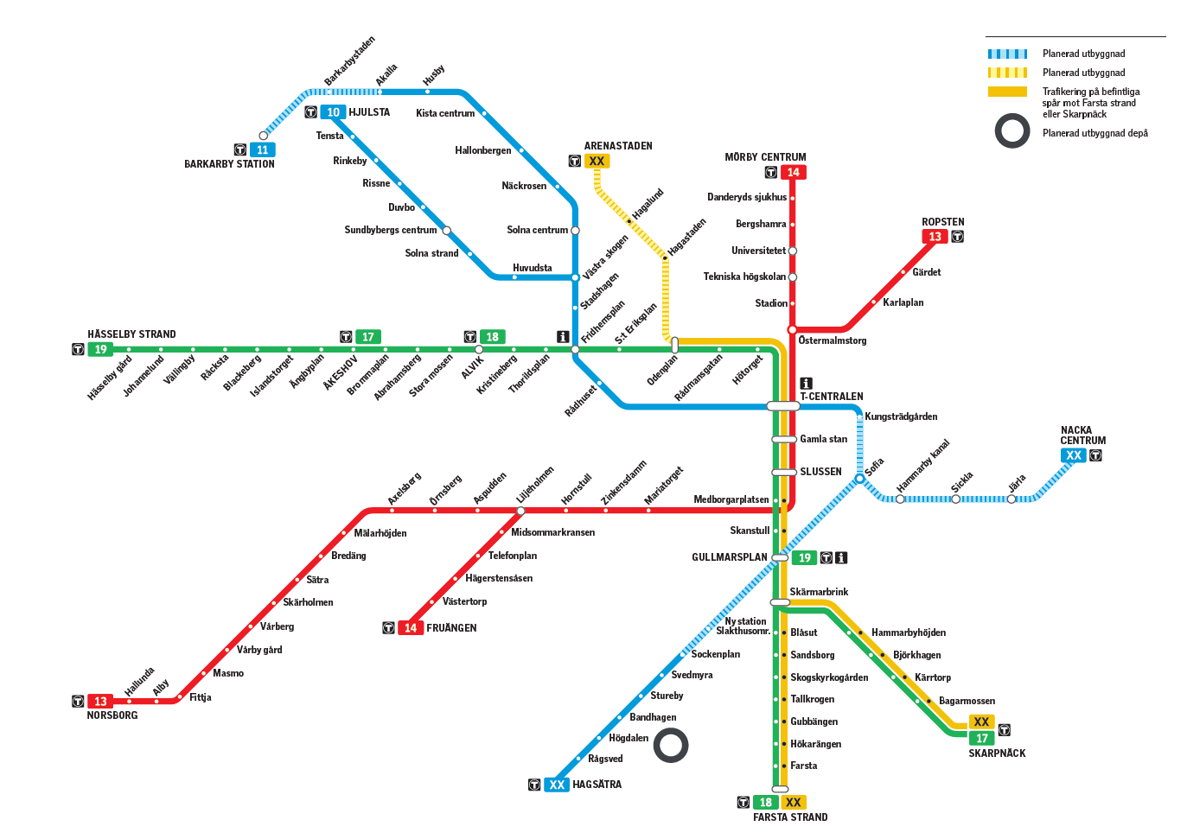

Properties at future subway stations
Source: Forum Fastighetsekonomi

Slide 29
Värtan
  Distance: ca 0,5 km
  Rent: 2 700-3 000 sek/sqm
Sofia/Östra Södermalm
  Distance: ca 1,5 km
  Rent: 2 500-3 000 sek/sqm
Frihamnen
  Distance: ca 1,5 km
  Rent: 1 800-2 300 sek/sqm
Skanstull
  Distance: <0,5 km
  Rent: 3 200-4 000 sek/sqm

Slide 30
Properties at future subway stations
3 500 – 5 000 sek/sqm
2 800 – 4 000 sek/sqm
2 500 – 3 200 sek/sqm
1 500 – 2 500 sek/sqm
Source: Forum Fastighetsekonomi

Slide 31
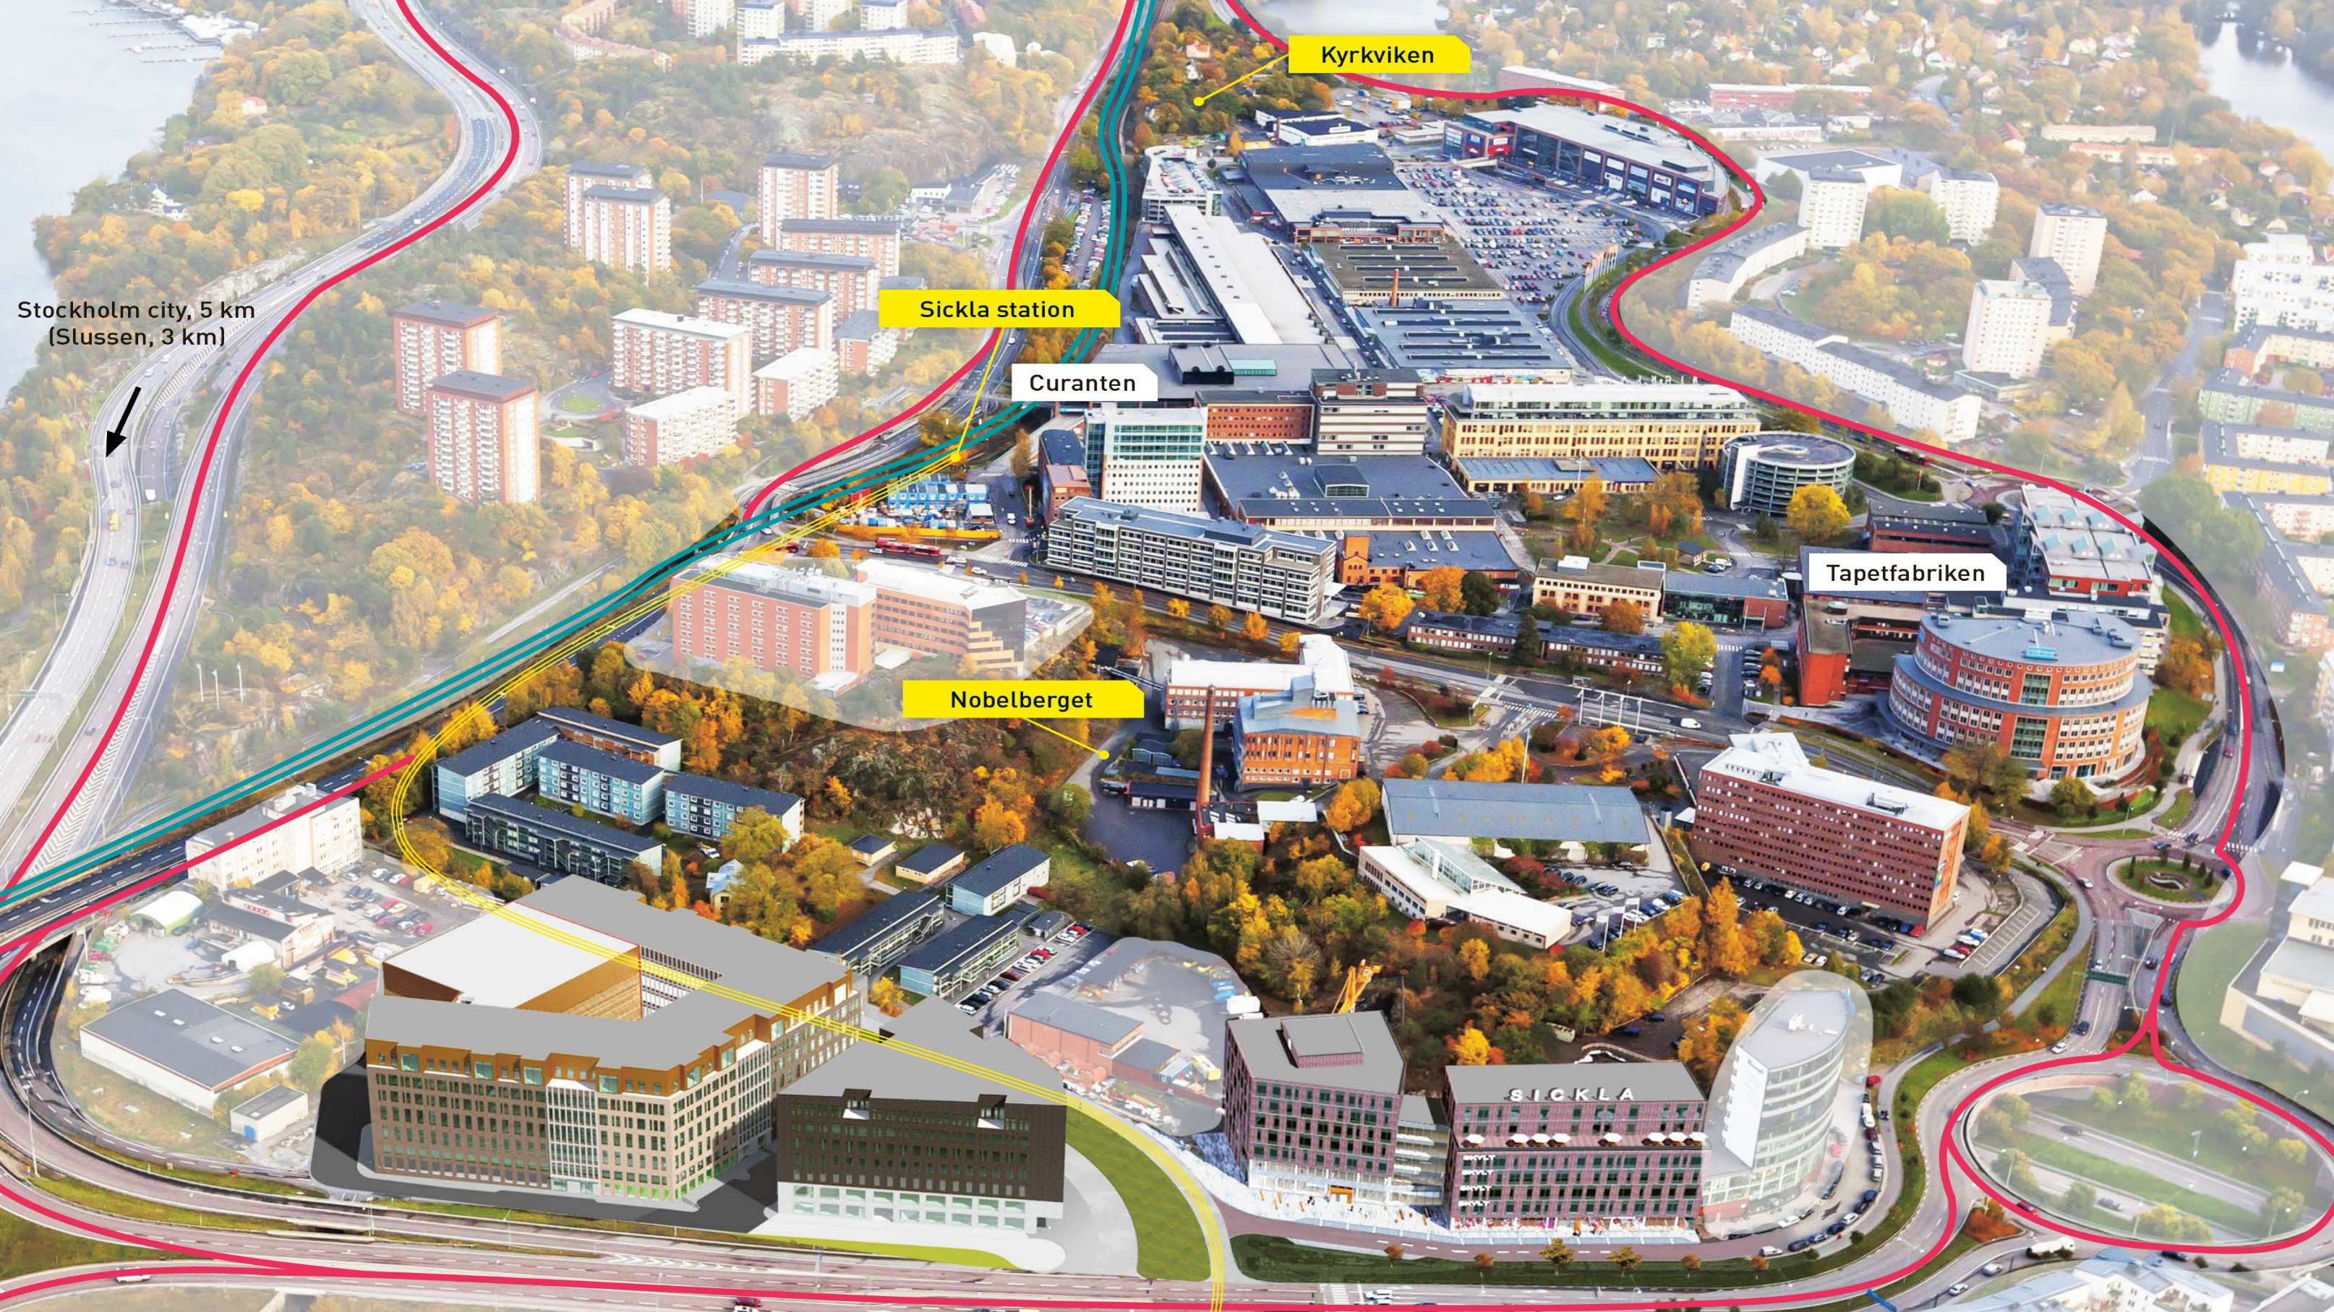
SICKLA
31
Notes:
För att visa var alla projekt i Sickla ligger.

Slide 32
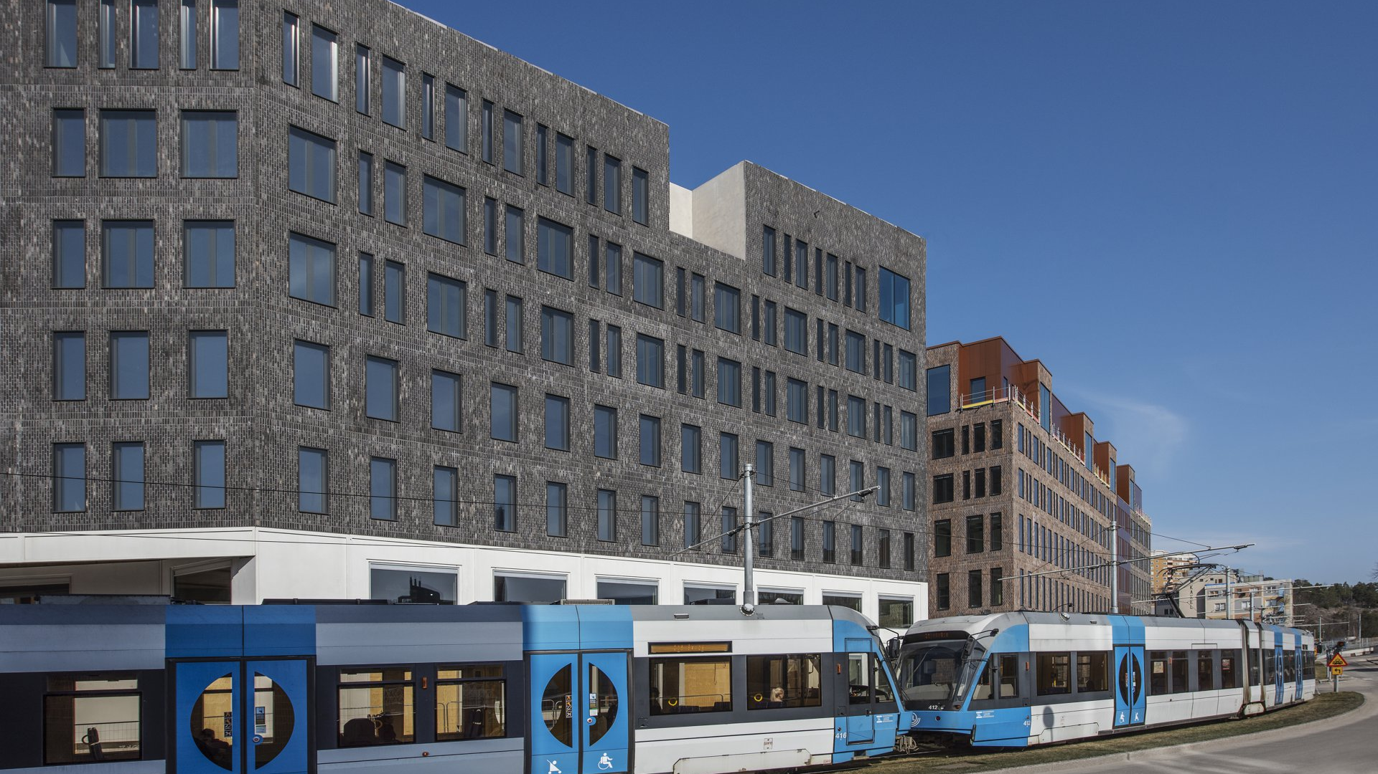
SICKLA FRONT II
COMPLETED PROJECT
Area 25,300 sqm
Investment SEK 810 M
Rental value ex premiums SEK 66 M
Completed 2018
Tenant: National Courts Administration
Notes:
Area 25 000 kvm
Investering 830 mkr
Hyresvärde exkl tillägg 63 mkr
Färdigställs 2018
Domstolsverket betydande hyresgäst

Slide 33
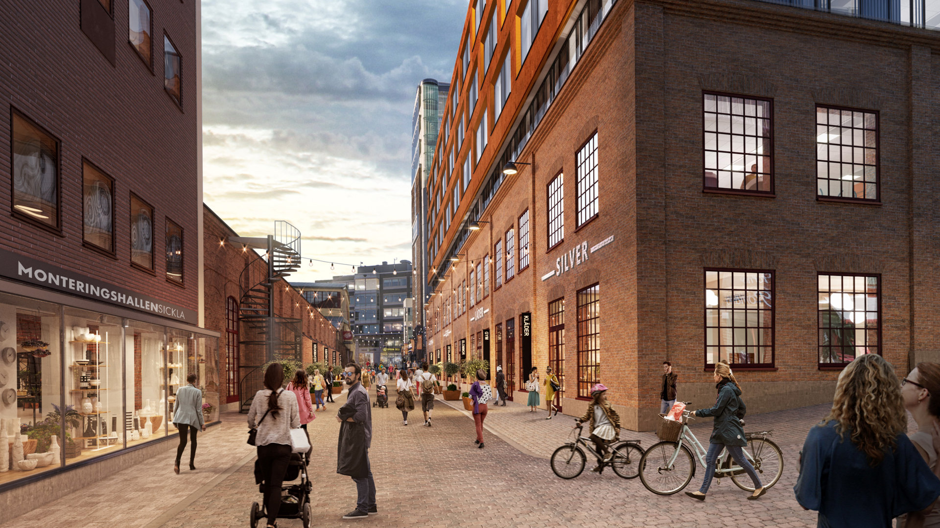
SICKLA 1898
DECIDED PROJECT
Area 11,700 sqm
Investment SEK 530 m
Completed 2020
A healthcare destination
Notes:
Om- och tillbyggnad för 9 000 kvm handel, kontor, och vårdverksamhet.
Ryms inom detaljplan.

Slide 34
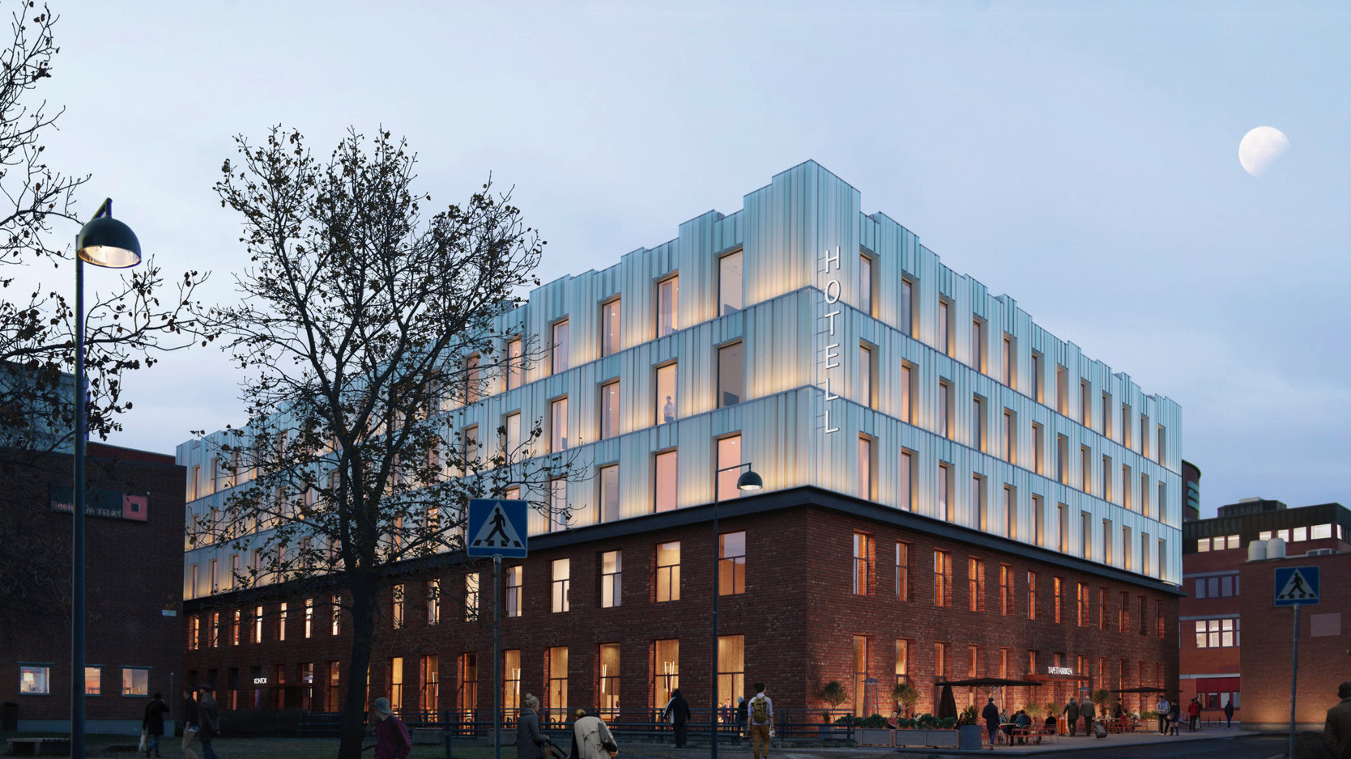
TAPETFABRIKEN
DECIDED PROJECT
Area 9,800 sqm
Investment SEK 390 m
Completed 2020
Tenant: Nordic Choise Hotels
Notes:
12 000 hotell och/eller kontorsverksamhet.
Byggstart planerad till mitten av 2017.

Slide 35
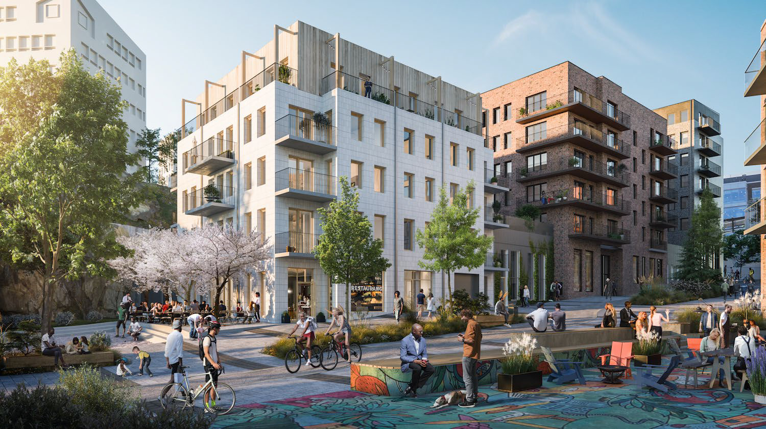
NOBELBERGET
DECIDED PROJECT
Area 4,100 sqm incl. garage
Investment SEK 60 m
Completed 2020
Garage under the first quarter

Slide 36
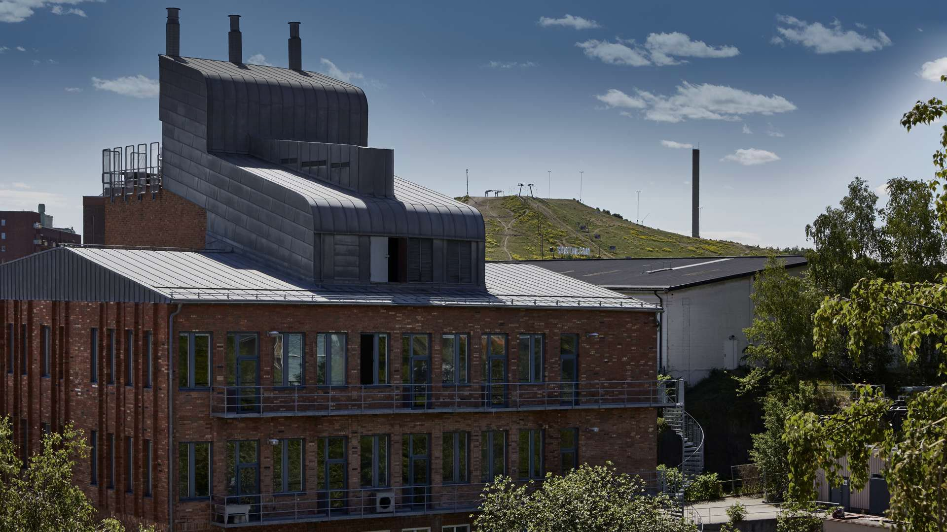
FORMALINFABRIKEN
DECIDED PROJECT
Area 2,000 sqm
Investment SEK 50 m
Rental value ex premiums SEK 4 m
Completed 2019
Office, café, restaurants and culture

Slide 37
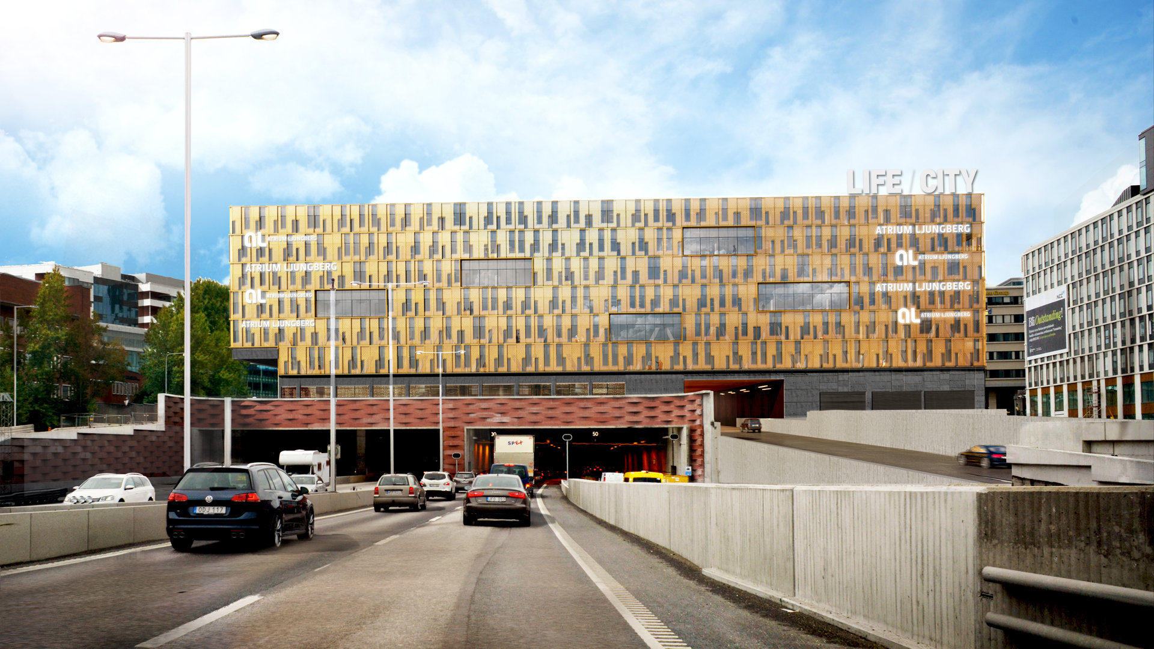
Life City
DECIDED PROJECT
Area 27,500 sqm
Investment SEK 1,870 m
Rental value ex premiums SEK 107 m
Completed 2021
Tenant: Academic Work 17,000 sqm
Notes:
Röstning i EU 20 november

Slide 38
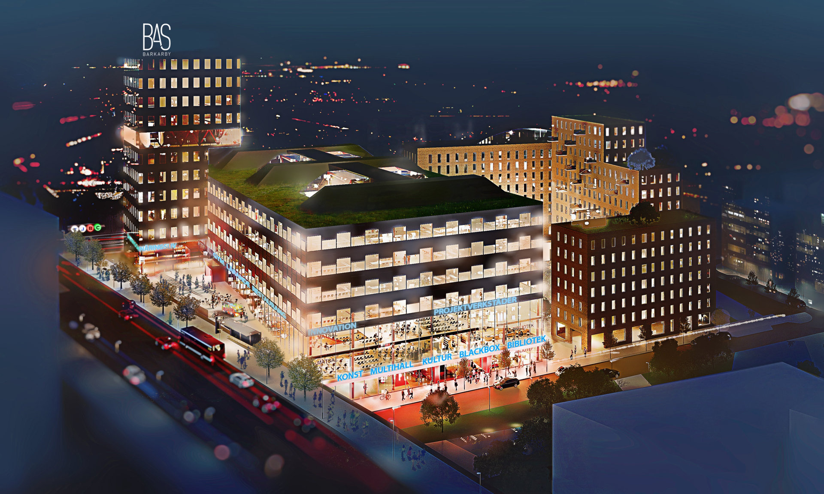
BAS BARKARBY
DECIDED PROJECT
Area 24,400 sqm
Investment SEK 830 m
Completed 2021
Education, culture, sports and business
Notes:
Markanvisning med en byggrätt om 50 000 kvm BTA.
Järfälla kommun hyr 10 800 kvm i första etappen för gymnasieutbildning, multihall, bibliotek och kultur.
Miljödom? Väntas sommaren 2018.
Byggstart beräknas av första etappen till tidigast sommaren 2018.

Slide 39
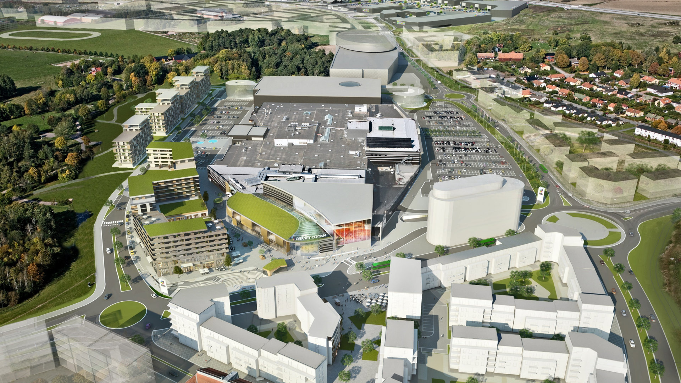
GRÄNBYSTADEN
- SOUTH ENTRANCE
COMPLETED PROJECT
Area 9,800 sqm
Investment SEK 360 m
Rental value ex premiums SEK 31 m
Completed 2018
Inaugurated 22 November

Slide 40
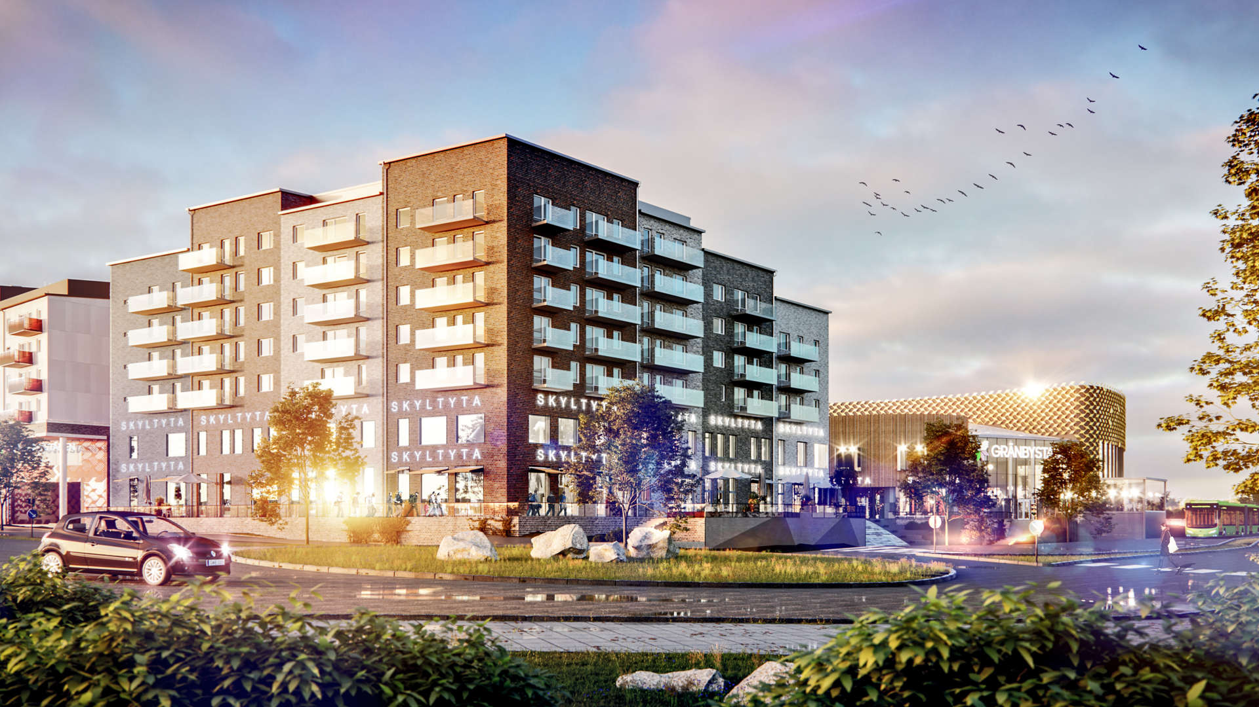
DECIDED PROJECT
gränby residentials
Area 17,200 sqm, 200 apartments
Investment SEK 710 m
Rental value ex premiums SEK 50 m
Completed 2019
Residential, office, retail, restaurants

Slide 41
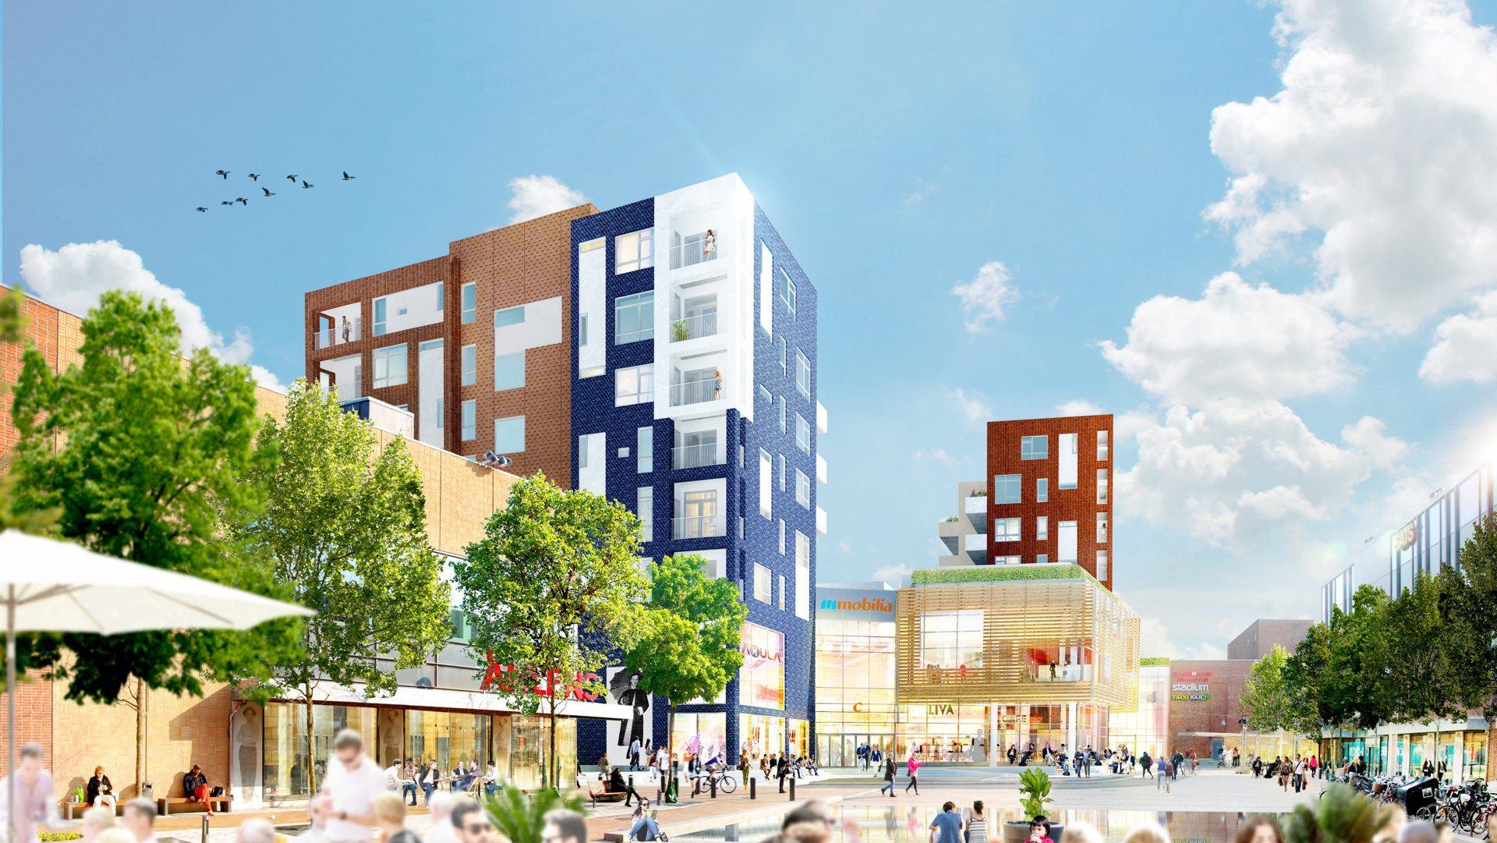
MOBILIA MALMÖ
DECIDED PROJECT
Area 13,200 sqm
Investment SEK 540 m
Rental value ex premiums SEK 37 m
Completed 2020
Residential, movie theatre, retail, children’s culture
Notes:
Ny- och tillbyggnad på ca 16 500 kvm för handel, bostäder och kulturverksamhet, samt fler restauranger mot torget.
Ryms inom detaljplan och planeras starta runt årsskiftet 2017/2018.

Slide 42
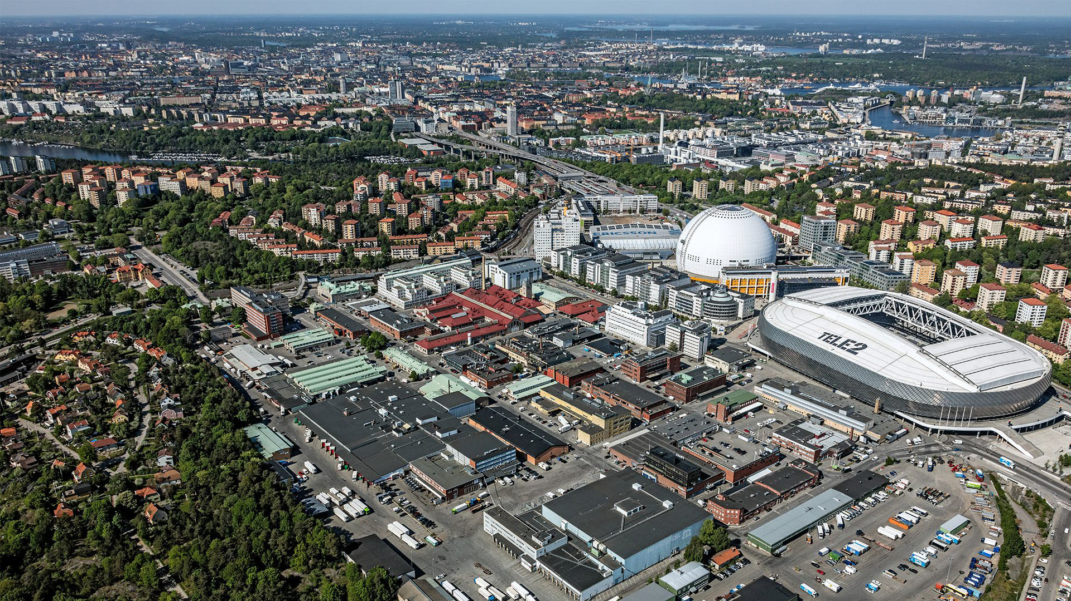
Letter of intent SLAKTHUSOMRÅDET
Area 200,000 sqm
Investment SEK 8 bn

Slide 43
Slakthusområdet – letter of intent
Total Development | Sqm GFA | Investment (SEK m)
Offices | 77 000
Residential | 44 000
Retail (lower floors) | 28 000
Culture | 11 000
Education | 7 000
Total | 167 000 | 7 000
Distribution by type
Initial purchase price | SEK 1 000 m
Investments projects | SEK 6 000 m
Option Palmfelt Center | SEK 1 000 m
Total | SEK 8 000 m

Slide 44

SHAREHOLDERS AND THE SHARE
44

Slide 45
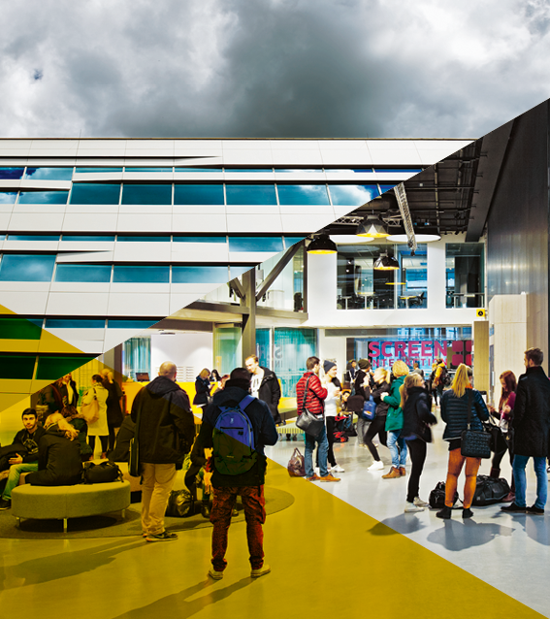
STRONG SHAREHOLDERS
31/12/2018 | Share of votes | Share of capital
Ljungberg family | 29.5 | 22.0
The Stockholm Consumer Cooperative society | 23.3 | 29.2
Holmström family | 19.7 | 12.4
Carnegie funds | 5.3 | 6.6
The mutual pension insurance company Varma | 4.9 | 6.1
AFA funds | 1.4 | 1.8
Handelsbanken funds | 1.2 | 1.5
Norges Bank | 0.9 | 1.2
Margaretha af Ugglas | 0.9 | 1.1
The mutual pension insurance company Ilmarinen | 0.8 | 1.1
Others (incl. 2.1% repurchased) | 12.0 | 17.0
Total shares | 100 | 100
45

Slide 46
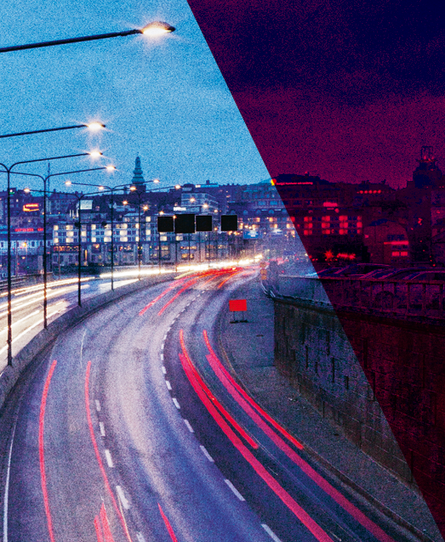
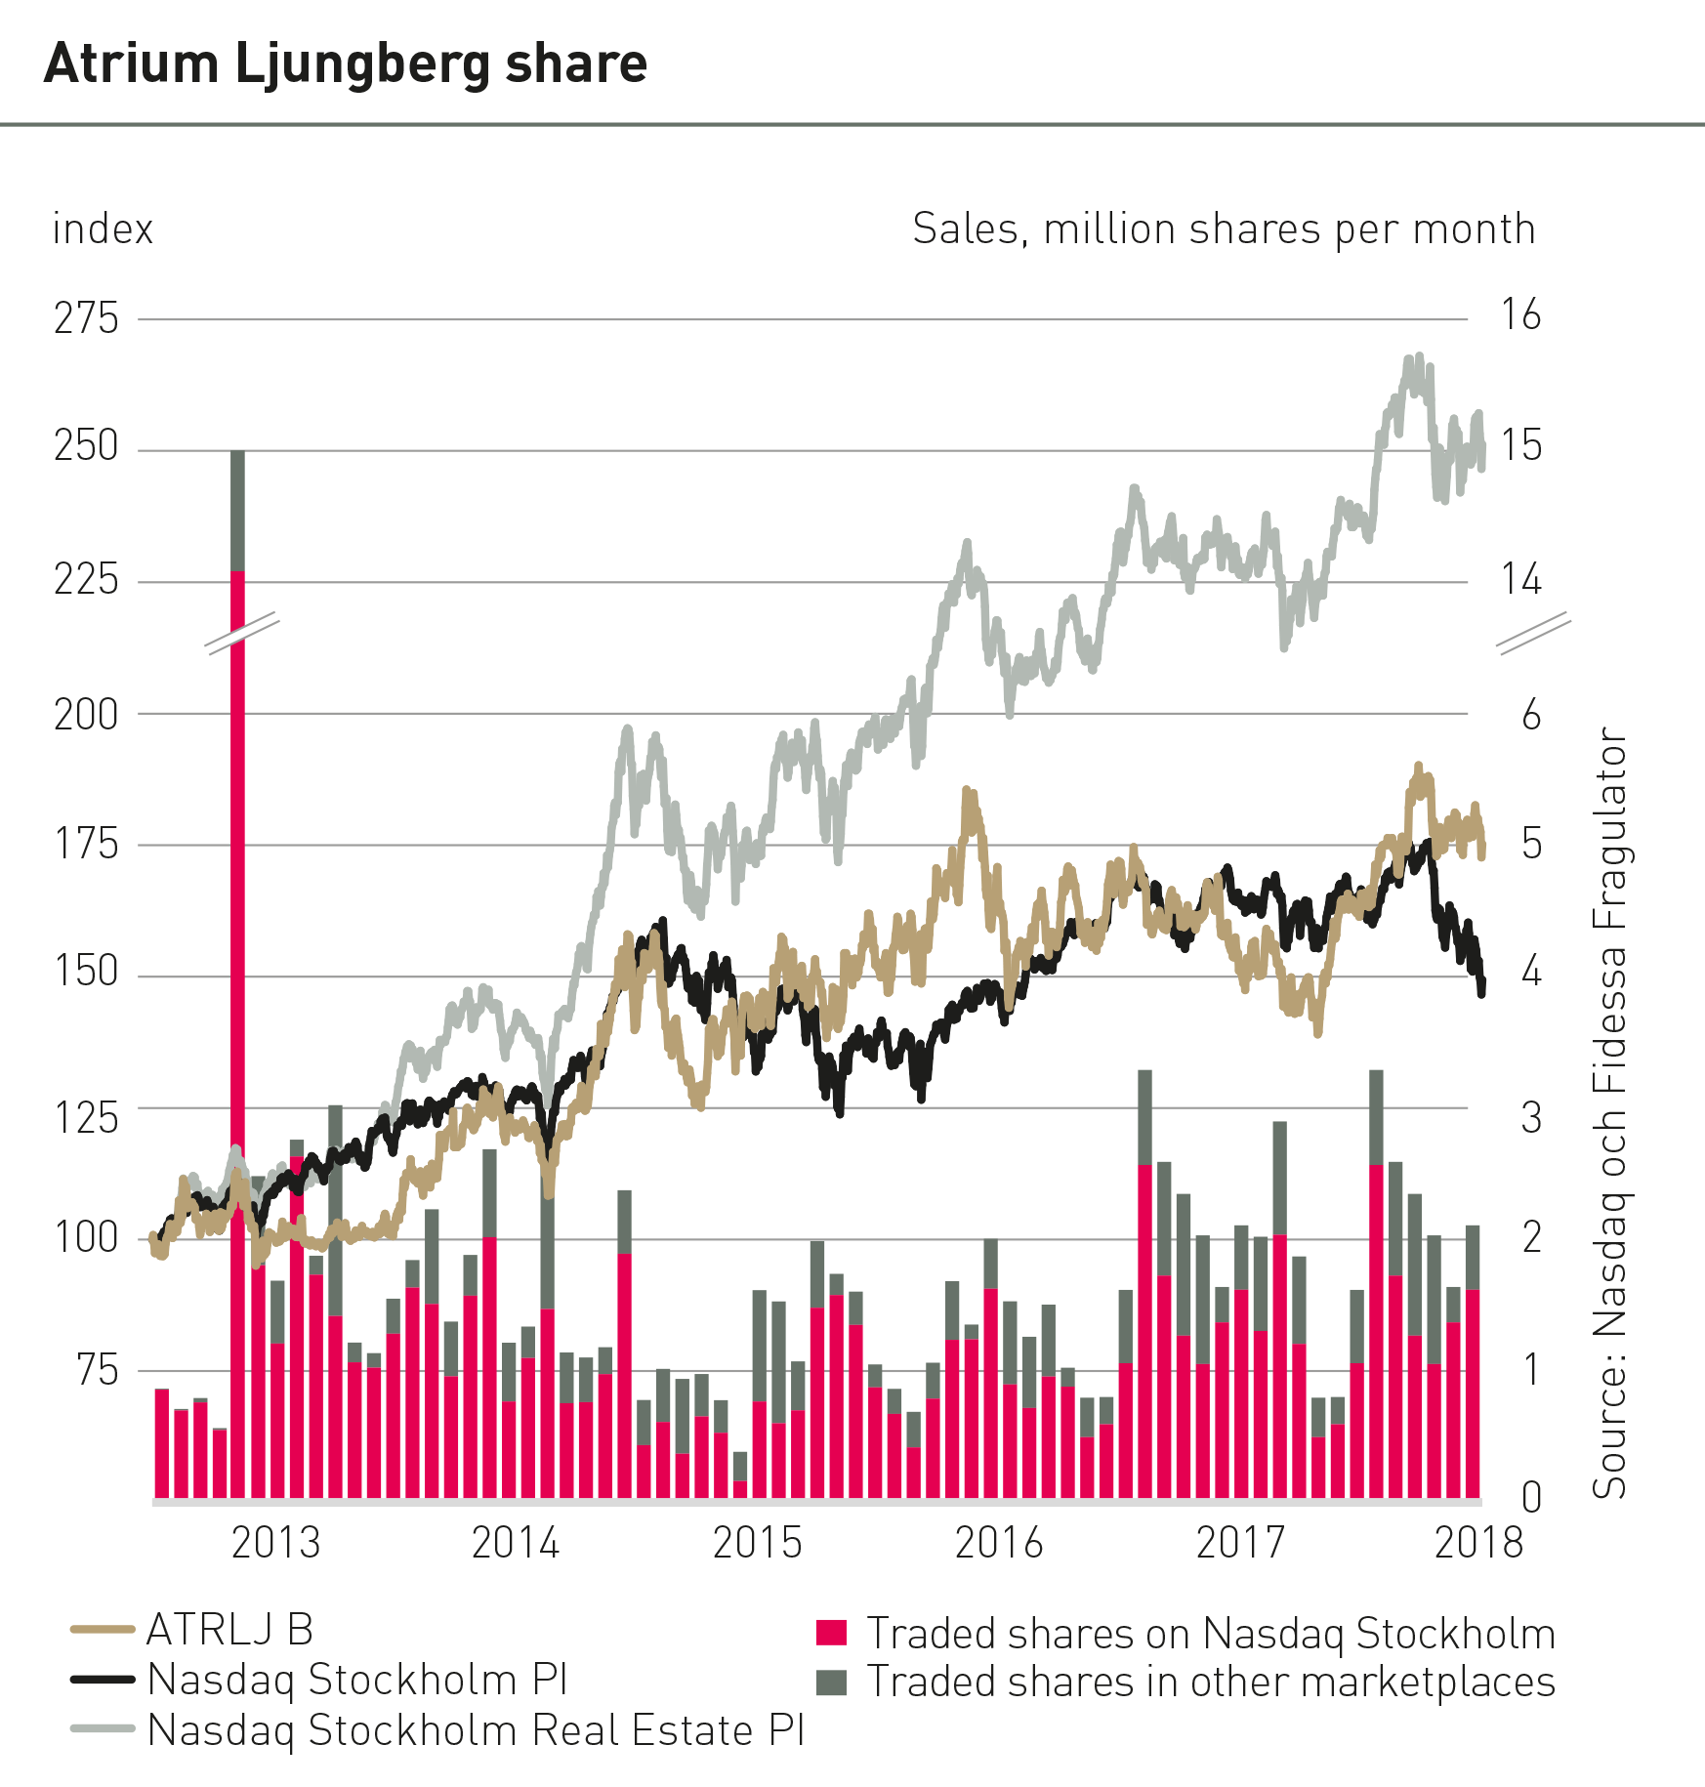
INCREASED SHARE LIQUIDITY
46

Slide 47

FINANCIAL INFORMATION
47

Slide 48
Consolidated income statement
MSEK |  | 2018 Jan-Dec | 2017 Jan-Dec | Δ %
Rental income |  | 2 412 | 2 389 | +1,0%
Property costs |  | -764 | -742 | +2,9%
Operating surplus |  | 1 648 | 1 647 | +0,1%
Central administration (property management) |  | -73 | -48
Project- and construction work |  | -59 | -47
Net financial items |  | -302 | -372
Profit/loss before changes in value |  | 1 214 | 1 180 | +2,9%
Change in the value of properties, unrealised |  | 2 516 | 1 817
Change in the value of properties, realised |  | 121 | -4
Change in the value of financial instruments |  | -69 | 116
Profit/loss before tax |  | 3 781 | 3 110
Tax |  | -329 | -551
Profit for the period |  | 3 453 | 2 559

Slide 49
Rental income
Rental income trend (MSEK)
 | 2018 1/1-31/12 | 2017 1/1-31/12 | Δ %
Like-for-like portfolio | 2 025 | 1 969 | +2,9
Non-recurring renum. | 5 | 53
Project properties | 140 | 90
Acquisitions | 116 | 67
Sold properties | 126 | 211
Rental income | 2 412 | 2 389 | +1,0
EPRA vacancy rate 5 %
Net letting positive SEK 144 m
Property cost trend (MSEK)
 | 2018 1/1-31/12 | 2017 1/1-31/12 | Δ %
Like-for-like portfolio | -631 | -613 | +2,8
Project properties | -56 | -42
Acquisitions | -45 | -24
Sold properties | -33 | -62
Property cost | -768 | -742 | +2,9

Slide 50
RENTAL INCOME AND OPERATING SURPLUS
Like-for-like rental income growth
Operating surplus and operating surplus margin
MSEK
%
Q1
Q2
Q3
Q4
Q1
Q2
Q3
Q4
Q1
Q2
Q3
Q4
Q1
Q2
Q3
Q4
2015
2016
2017
2018
Notes:
Byt plats

Slide 51
INVESTments of 1,758 MSEK in held properties
MSEK

Slide 52
Consolidated assets
(MSEK) | 2018 31/12 | 2017 31/12
Investment properties | 43 310 | 39 991
Goodwill | 225 | 240
Other fixed assets | 45 | 45
Total fixed assets | 43 579 | 40 276
Development properties | 891 | 870
Current assets | 323 | 1 272
Liquid assets | 335 | 344
Total current assets | 1 549 | 2 487
Total assets | 45 128 | 42 763

Slide 53
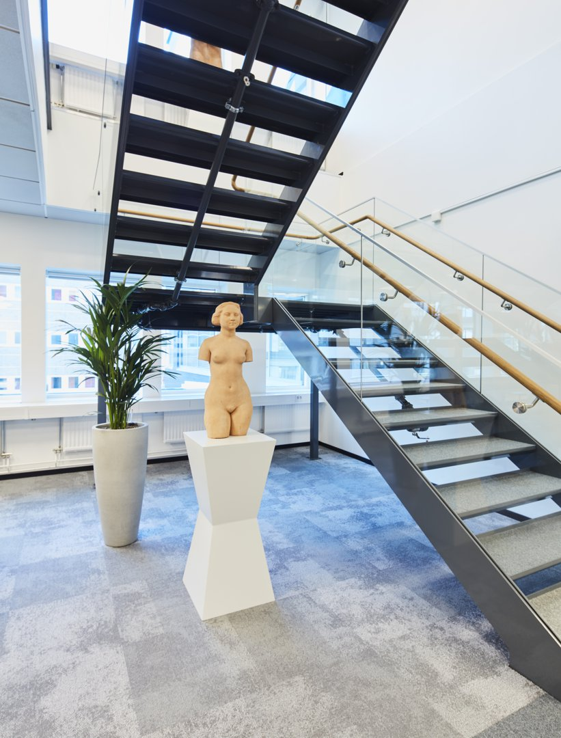
CHANGES IN PROPERTY VALUE
Unrealised changes in value, properties
Unrealised gain of SEK 2,516 million
The increase in mainly driven by increases in operating surplus (80%)
 | 2018 | 2017
Change in yield requirements | 487 | 947
Change in operating net etc. | 2 029 | 865
Building rights | - | 5
Total | 2 516 | 1 817

Slide 54
LOW FINANCIAL RISK AND STRONG KEY RATIOS
year
%
Interest-bearing liabilities of SEK 18.5 billion
Gearing ratio 41.9 %
Average interest rate 1.6 %
Fixed interest term 4.1 years
Capital commitment 4.6 years
Five Nordic banks, capital market, direct financing
Commercial paper backed by secured credit lines
Baa2 credit rating by Moody’s
2013
2014
2015
2016
2017
2018

Slide 55
Increasing share of capital market financing
Development, financing sources 2013-2018
Interest-bearing liabilities
Q1
Q2
Q3
Q4
Q1
Q2
Q3
Q4
Q1
Q2
Q3
Q4
Q1
Q2
Q3
Q4
Q1
Q2
Q3
Q4
Q1
Q2
Q3
Q4
2013
2014
2015
2016
2017
2018
Notes:
Januari 2013 gjordes första certifikatet
Oktober 2013 gjordes första obligationen under MTN-programmet

Slide 56

AL ON CAPITAL MARKET (Q4)
Swedish MTN-programme (SEK, NOK, EUR)
Size 10 000 MSEK
New issuing: 2016: 1 300 MSEK (3)
2017: 4 100 MSEK (10)
2018: 2 750 MSEK (8)
Total outstanding: 7 614 MSEK
Green Bond Framework
Outstanding Green Bond: 4 500 MSEK
CP Program, total outstanding: 1 785 MSEK
56

Slide 57

forecast 2019
Profit before changes in value
SEK 1,200 m
(SEK 1,214 m)
Investments
SEK 2,000 m
(SEK 1,758 m)

Slide 58
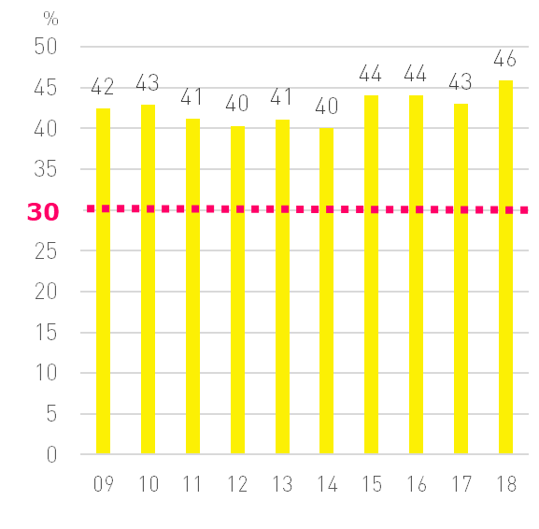
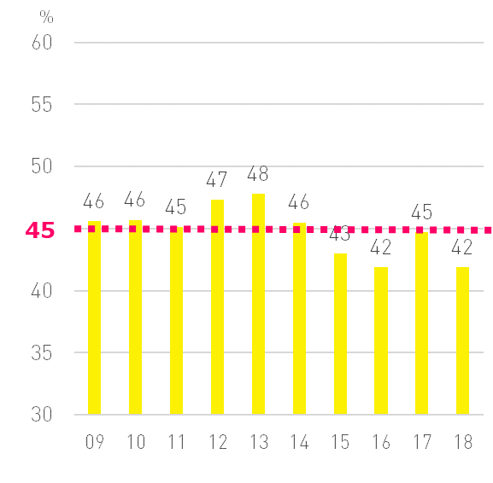
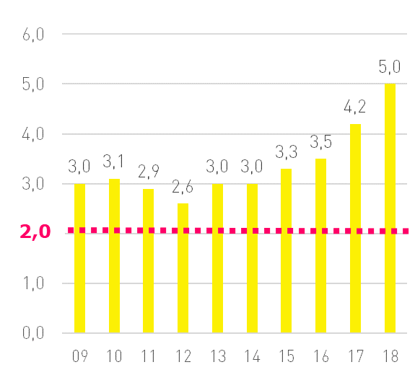
STRONG FINANCIAL KEY RATIOS
Equity/asset ratio, %
Interest coverage ratio, multiple
Gearing ratio, %
58

Slide 59
PROFITS BEFORE CHANGES IN VALUE
MSEK

Slide 60
STRONG HISTORY OF INCREASING DIVIDENDS
SEK/share

Slide 61
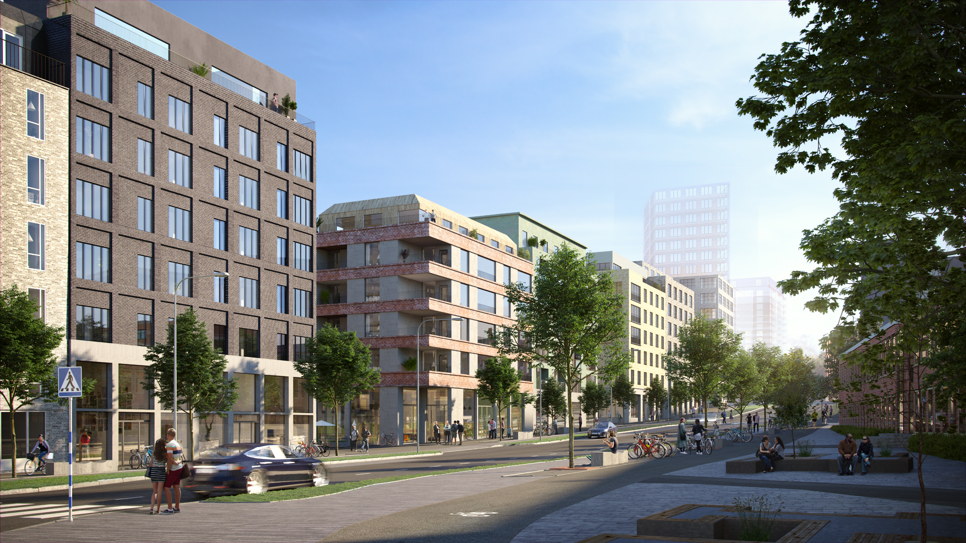
INVESTING IN ATRIUM LJUNGBERG
Stable dividend yield
Low financial risk
Potential for good value growth
Sustainable urban development
61

Slide 62
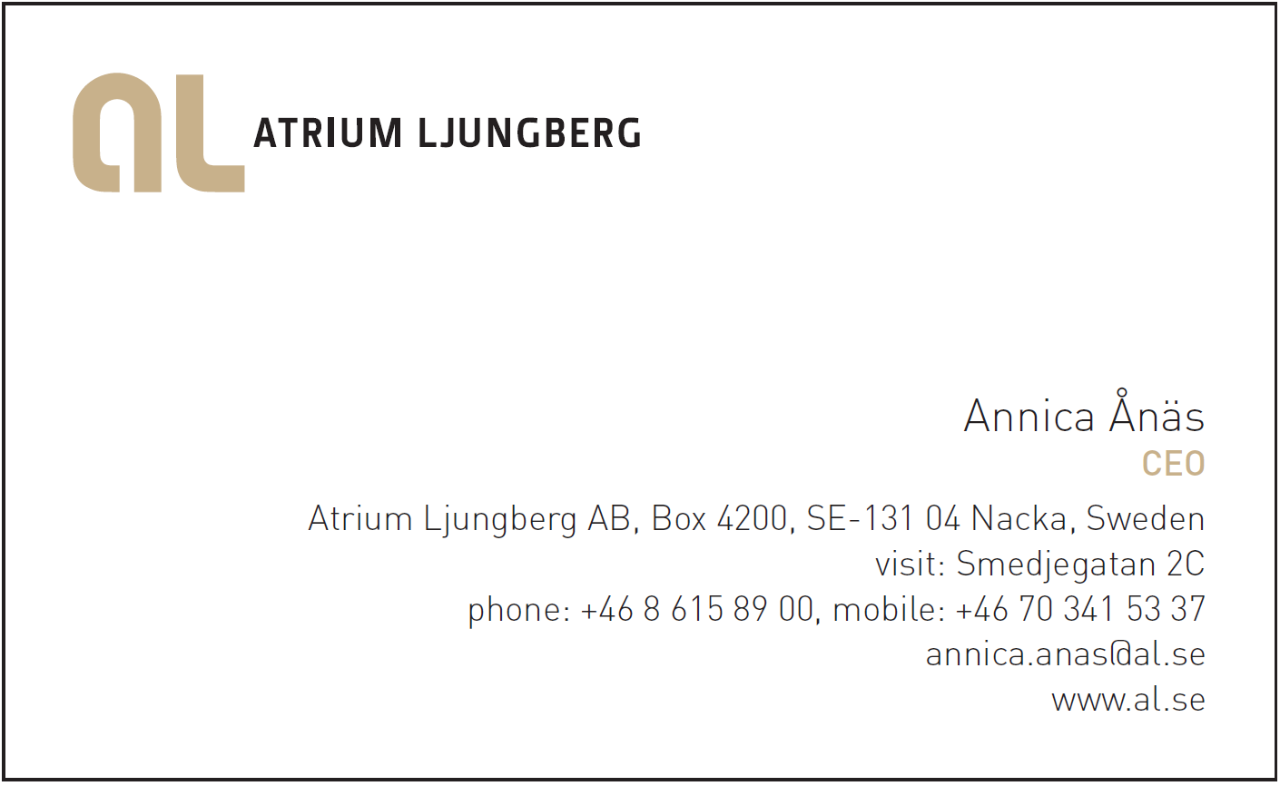
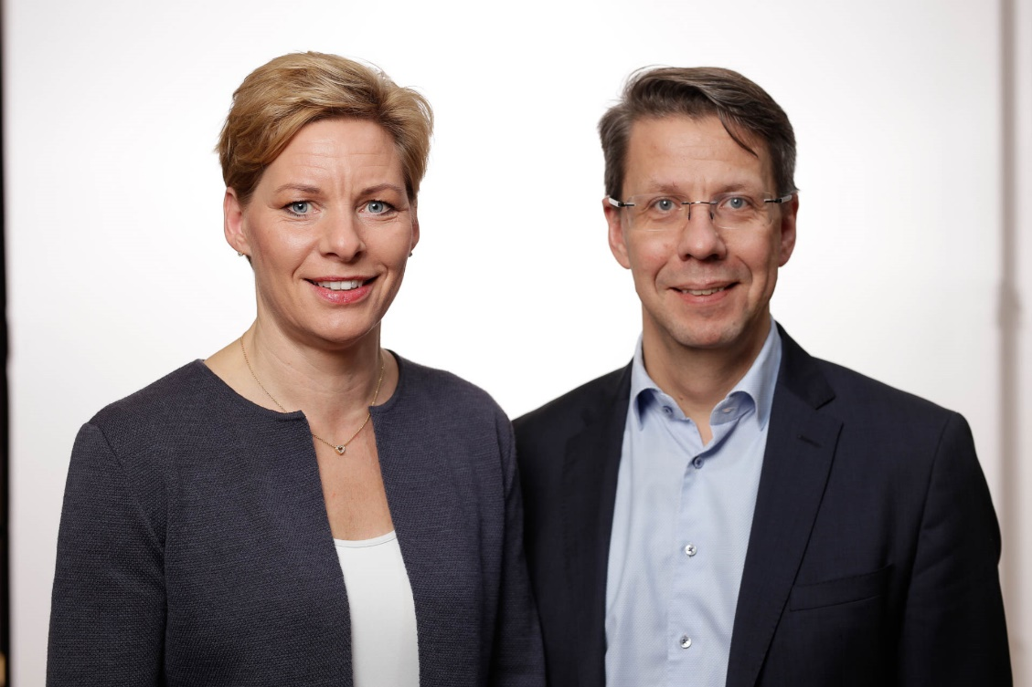
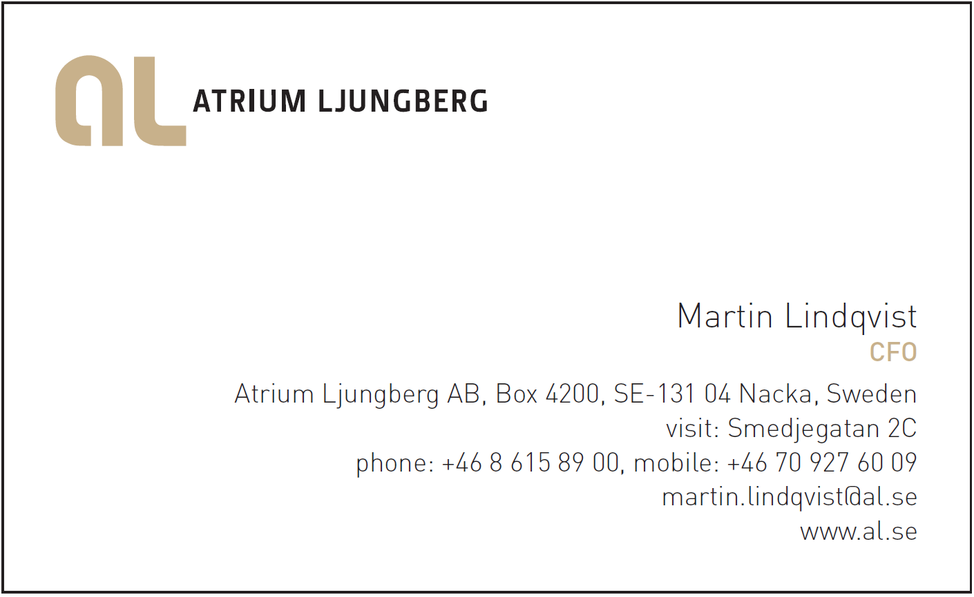
Contact
62

